Slide 1
Curriculum Forum
Secondary
Tuesday 6 June 2017
2017/32517

Slide 2
Agenda
Time | Session | Presenter/s
8.45 – 9.15 | Teaching, Learning and Assessing HASS HPE | Mandy Hudson Adriana Douglas
9.15 – 10.15 | Ways of Teaching and Ways of Assessing HASS HPE | Carolyn Fleischer Dino Manalis
10.15 – 10.45 | Morning Tea
10.45 – 12.00 | Applying the Ways of Teaching and Ways of Assessing to develop assessment tasks, marking keys and/or teaching and learning outlines HASS HPE | Carolyn Fleischer Dino Manalis
Notes:
The Agenda for the morning session only. The afternoon sessions are for English, Science and Mathematics.

Slide 3
Australian Professional Standards for Teachers
The professional learning will address the following Australian Professional Standards for Teachers:
2.1Content and teaching strategies of the teaching area
2.2 Content knowledge and organisation
2.3 Curriculum, assessment and reporting
3.2 Plan, structure and sequence learning programs
6.2 Engage in professional learning to improve practice
6.3 Engage with colleagues and improve practice

Slide 4
The Outline
The Western Australian Curriculum and Assessment Outline:
sets out the knowledge, understanding, skills, values and attitudes that students are expected to acquire, and guidelines for the assessment of student achievement,
is mandated for all Western Australian students,
provides comprehensive information that schools can use to plan student learning programs, assess student progress and report to parents.

Slide 5
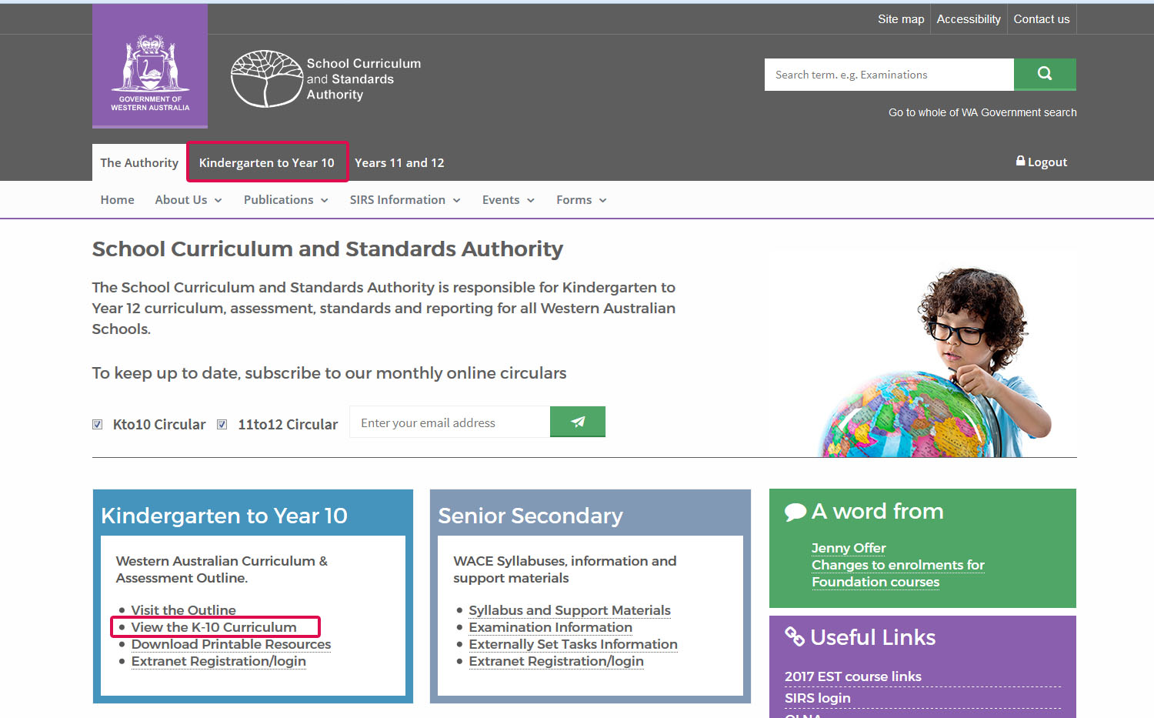

Slide 6
The teaching, learning and assessment process
STEP 2
Plan for assessment
SCSA
Ways, and principles, of assessment
Develop assessment tasks and
marking keys
STEP 1
School
SCSA
STEP 3
Establish content to be taught
Assessment policy and assessment
plans
Assessment support materials
SCSA
Western Australian Curriculum and Assessment Outline
School
Teaching and learning programs
School
Assessment tasks
and marking keys
START
STEP 6
Common understandings
Assign a grade for reporting
School
SCSA
Student assessment
records
Principles of teaching, learning and assessment
Policy Standards for Pre-primary to Year 10: Teaching, Assessing and Reporting
Judging Standards
SCSA
Pre-Primary to Year 10: Assessment and Reporting Policy
Administer and mark assessment tasks
School
School
STEP 4
School report
SCSA
Record results and collate
evidence
STEP 5

Slide 7
STEP 1
Establish content to be taught
School Curriculum and Standards Authority
Western Australian Curriculum and Assessment Outline
Pre-primary to Year 10: Teaching, Assessing and
Reporting Policy
Teaching support materials
School
Year level teaching and learning programs

Slide 8
Pre-primary to Year 10: Teaching, Assessing and Reporting Policy
5.1 Curriculum
Schools will implement the Pre-primary to Year 10 Western Australian Curriculum in accordance with:
the Policy Standards for Pre-primary to Year 10: Teaching, Assessing and Reporting
the Principles of Teaching, Learning and Assessment detailed within the Outline.
Notes:
Reference the Pre-primary to Year 10: Teaching, Assessing and Reporting Policy which requires all schools to implement the Western Australian Curriculum and Assessment Outline.
The Pre-primary to Year 10 Western Australian Curriculum
provides a coherent and comprehensive set of prescribed
content and achievement standards which schools will use to
plan student learning programs, assess student progress and
report to parents.

Slide 9
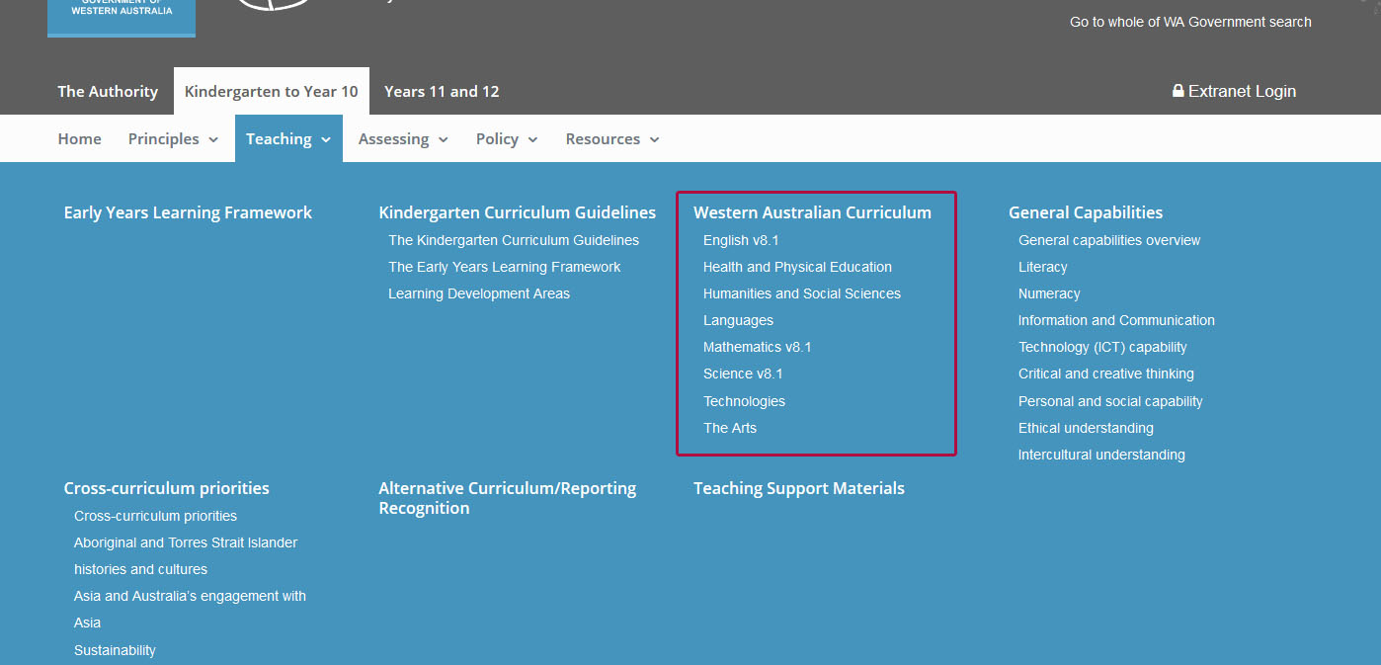

Slide 10
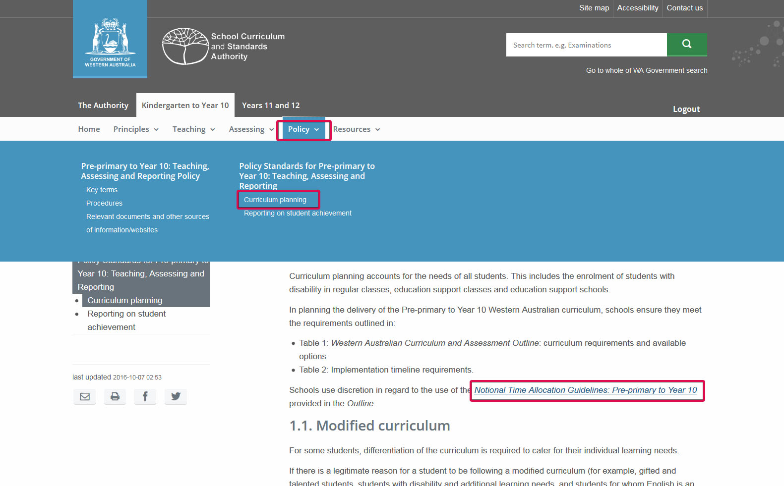

Slide 11
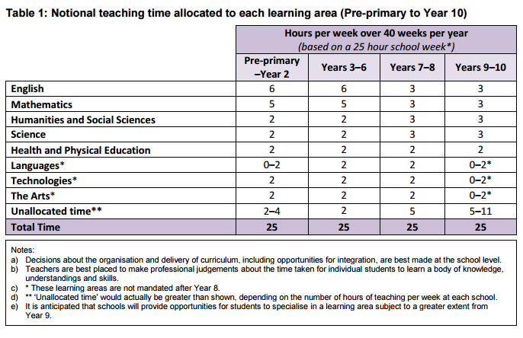
Notes:
The notional time allocation is provided for each learning area from Pre-primary to Year 10, along with the mandated years the curriculum is to be taught and any specific delivery requirements. For example, Technologies and The Arts.

Slide 12
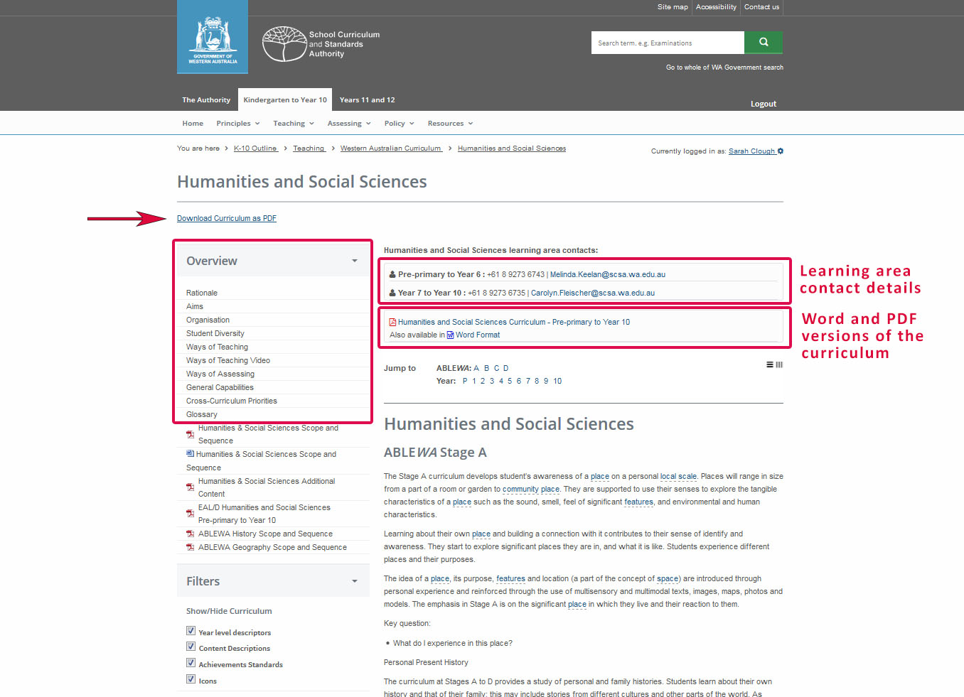

Slide 13
Teaching and learning programs
Teachers, when developing a program for their students, should consider:
the timing and sequencing of the year level syllabus content
the range of learning experiences through which students can apply the knowledge, skills and concepts from the syllabus content
the selection of resources to support teaching and learning experiences
the implementation of the principles of teaching and learning as articulated in the ‘Ways of teaching’ in the Overview of the syllabus.

Slide 14
STEP 2
Plan for assessment
School Curriculum and Standards Authority
Pre-primary to Year 10: Teaching, Assessing and Reporting Policy
Principles of assessment
Ways of assessing
School
School assessment policy and assessment plans

Slide 15
Pre-primary to Year 10: Teaching, Assessing and Reporting Policy
5.2 Assessment
Schools will monitor and assess individual student achievement referring to the Principles of Teaching, Learning and Assessment detailed within the Outline.
Schools must provide their school community with an assessment and reporting policy that is based on the Principles of Teaching, Learning and Assessment.
Notes:
The requirements for Assessment are clearly articulated in the
Pre-primary to Year 10: Teaching, Assessing and Reporting
Policy.
Schools will:
Monitor and assess individual student achievement, referring to Principles of Teaching, Learning and Assessment
Use student information to plan future learning programs

Slide 16
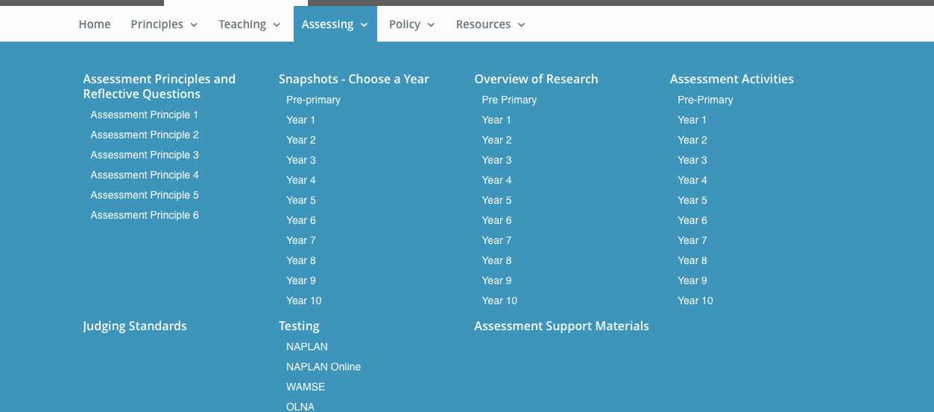
An extranet login is required to access materials.

Slide 17
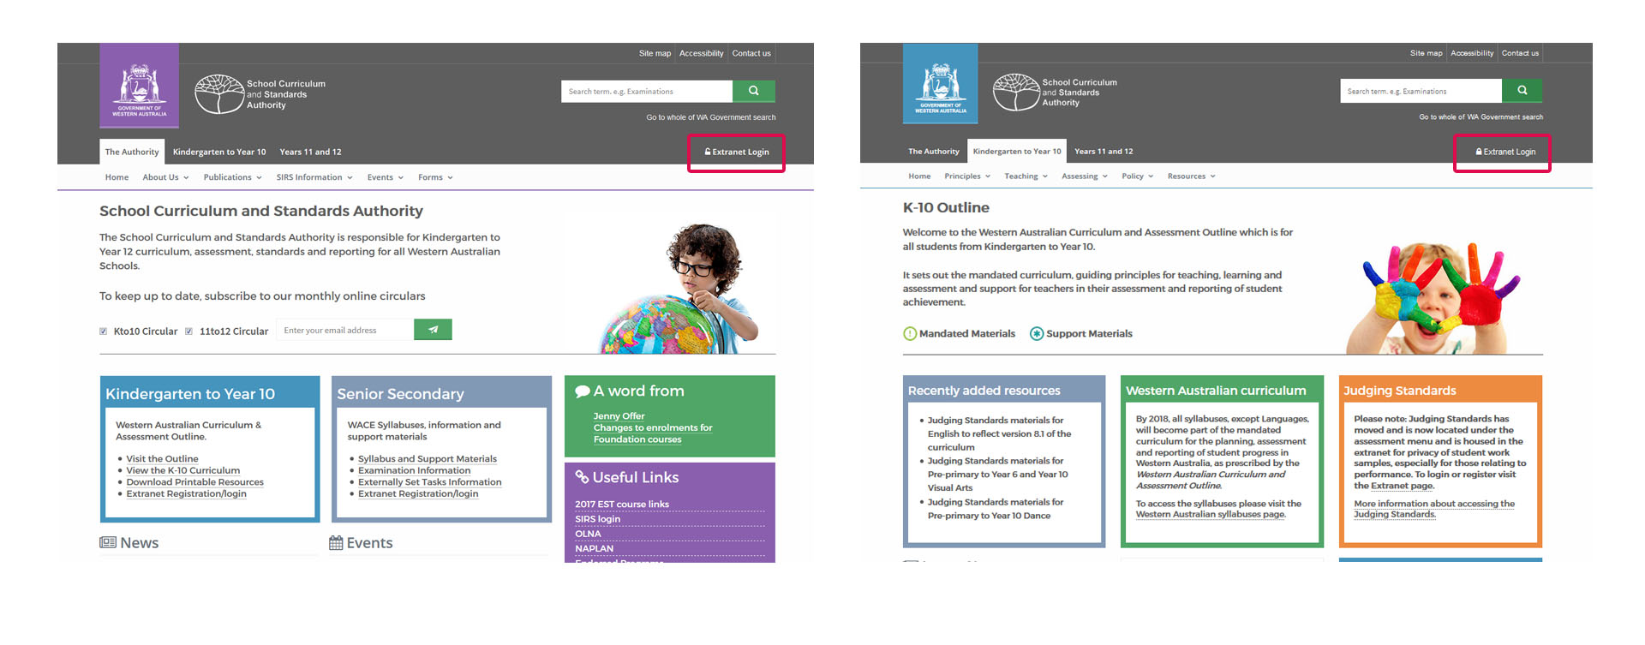
Notes:
Indicate the different ways to access Judging Standards (later slides shows the login page) and the materials are housed behind an extranet due to performance videos in HPE, Arts and English.

Slide 18
Ways of Assessing
Assessment should arise naturally out of the teaching and intended learning of the curriculum and syllabus.
The Ways of assessing complement Ways of teaching and aim to support teachers in developing effective assessment practice. These complement the principles of assessment in the Western Australian Curriculum and Assessment Outline. Assessment snapshots illustrate the assessment principles within a classroom or school context.

Slide 19
Assessment tasks
and marking keys
Assessment support materials
Achievement Standards
Assessment Pointers
School Curriculum and Standards Authority
Develop assessment tasks and marking keys
STEP 3
School

Slide 20
Assessment tasks
‘Schools will develop and administer assessments in relation to the content of the Pre-primary to Year 10 Western Australian Curriculum.’
5.2, Assessment, Policy Standards for Pre-primary to Year 10: Teaching, Assessing and Reporting
Assessment tasks provide:
a comprehensive sampling of the syllabus content
clear instructions on what is to be done, the conduct and completion of the task
opportunities for the full range of student achievement.
Notes:
The Pre-primary to Year 10: Teaching, Assessing and Reporting Policy states schools will:
Ensure assessments enable all students to demonstrate their knowledge, understandings and skills in relation to the year level achievement standard

Slide 21
Marking keys
Develop the marking key:
with the assessment task
to provide feedback to students
to ensure the fair and valid ranking of student achievement/performance.
It is important the judgements of student achievement are reliable. A marking key helps to ensure a consistent interpretation of the criteria that guide the awarding of marks.

Slide 22
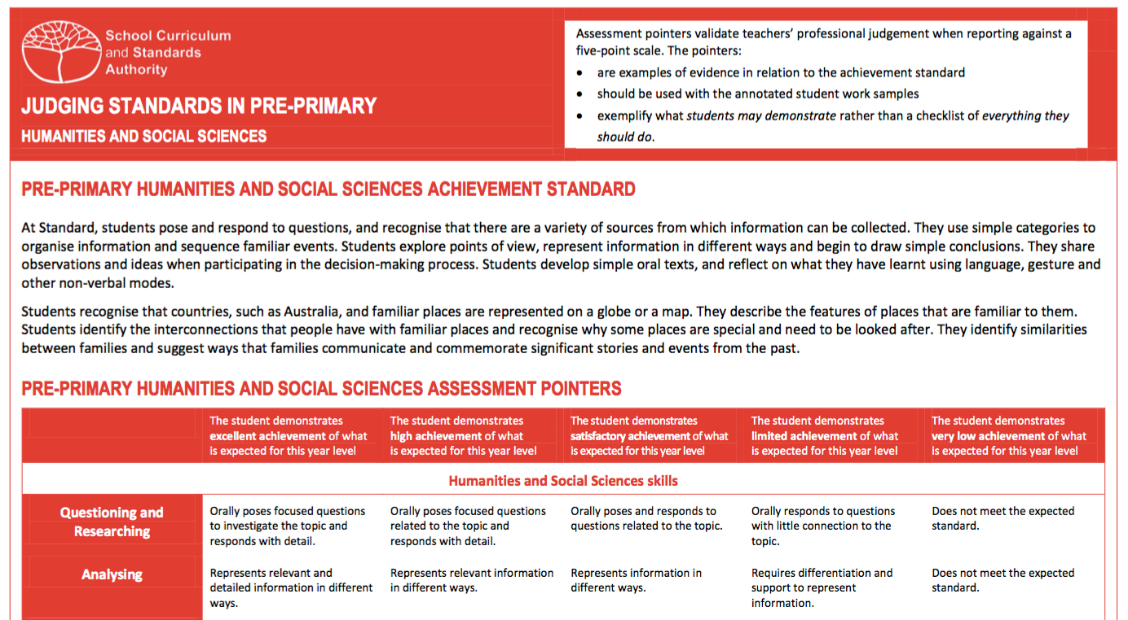
Achievement Standards
The achievement standard describes an expected level that the majority of students are achieving or working towards by the end of a given year of schooling. Some students will have progressed beyond the achievement standard; others will need additional support.
The Assessment Pointers provide teachers with the observable qualities of student performance at standard (C), above the standard (A or B) and below the standard (D). The pointers are supported by annotated student work samples.

Slide 23
Common
understandings
Reflect on teaching
practice
School
Principles of Teaching,
Learning and Assessment
Assessment Snapshots
School Curriculum and Standards Authority
Administer and mark assessment tasks
STEP 4

Slide 24
Marking assessment tasks
use numerical marks, not grades
modify the marking key to reflect unexpected student responses
share the marking key with the students
‘Schools will develop processes to support all teachers in making valid and reliable judgements.’
5.2, Assessment, Policy Standards for Pre-primary to Year 10: Teaching, Assessing and Reporting
Notes:
Indicate that:
numerical marks (not grades, checklists or other ratings) are used
refining the marking key for a task may need to occur after reading a selection of student responses (if the students come up with unexpected, alternative approaches)
sharing the marking key with the students is an effective teaching tool
should be shared with students when the work is handed back (in some cases, should be shared beforehand, e.g. research tasks, performance tasks)
Note: if there is more than one class in a year then typically:
all the same (or similar) assessment tasks are used for all classes
marking keys and marking strategies are used to ensure that all the students’ marks are ‘on the same scale’ (this is called internal comparability)
security issues need to be considered when using the same task at different times/days to ensure fairness

Slide 25
Student assessment
records
School
School Curriculum and Standards Authority
Record results and collate evidence
Pre-primary to Year 10: Teaching Assessing and Reporting policy
STEP 5

Slide 26
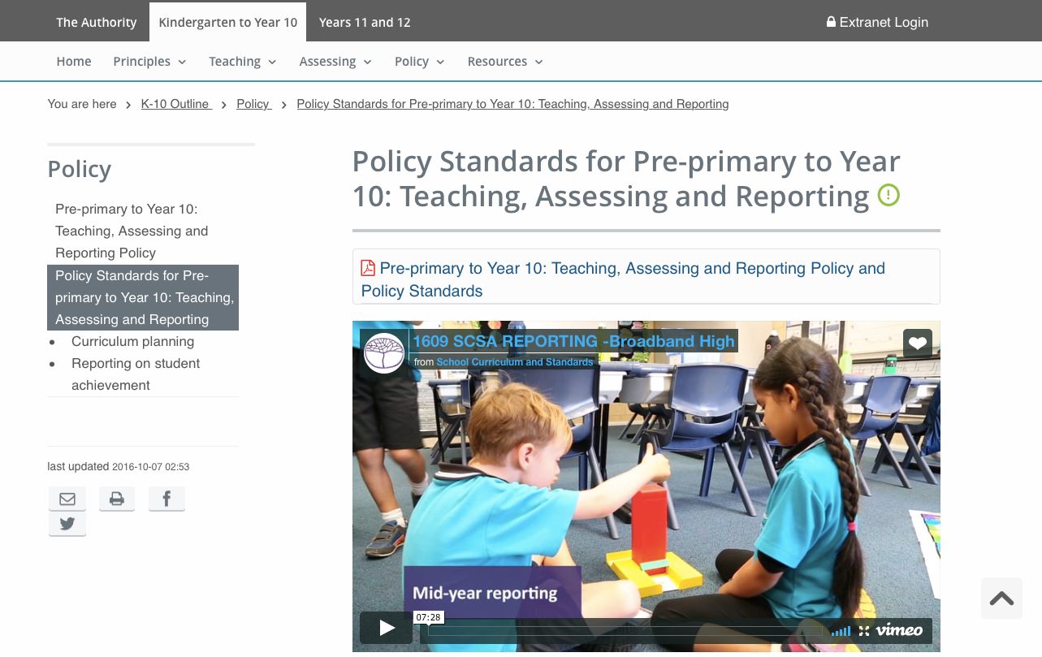

Slide 27
School Curriculum and Standards Authority
STEP 6
Assign a grade for reporting
Policy Standards for Pre-primary to Year 10: Teaching, Assessing and Reporting
Achievement Standards
Judging Standards Materials
School
School reports

Slide 28
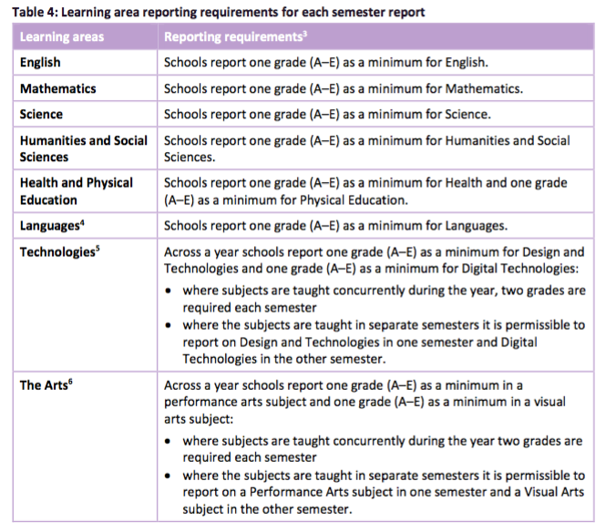
Notes:
Minimum reporting requirements as set out in the Policy Standards for Pre-primary to Year 10: Teaching, Assessing and Reporting.
Note with HPE that a grade is required for Health Education and a grade for Physical Education.

Slide 29
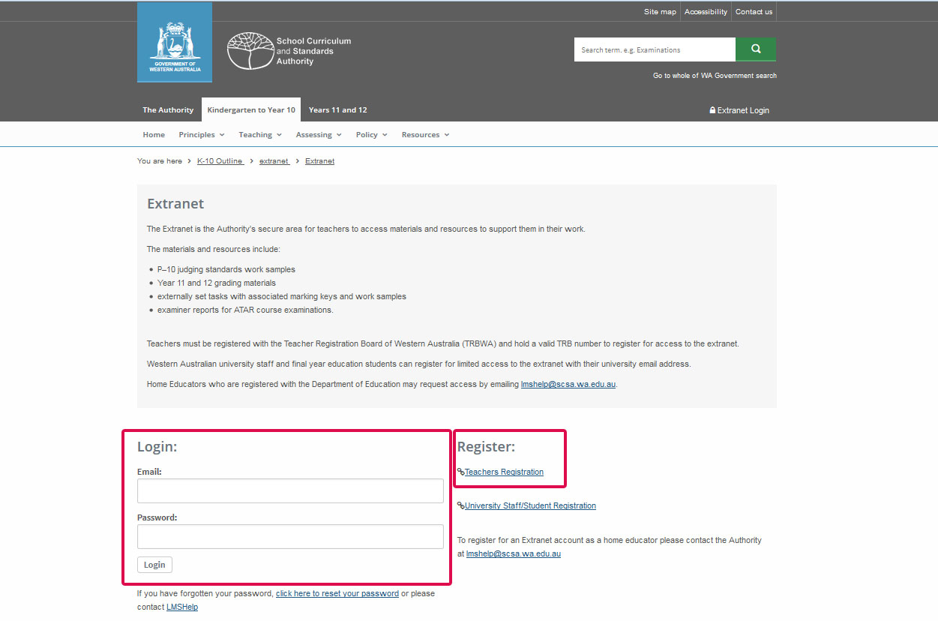

Slide 30
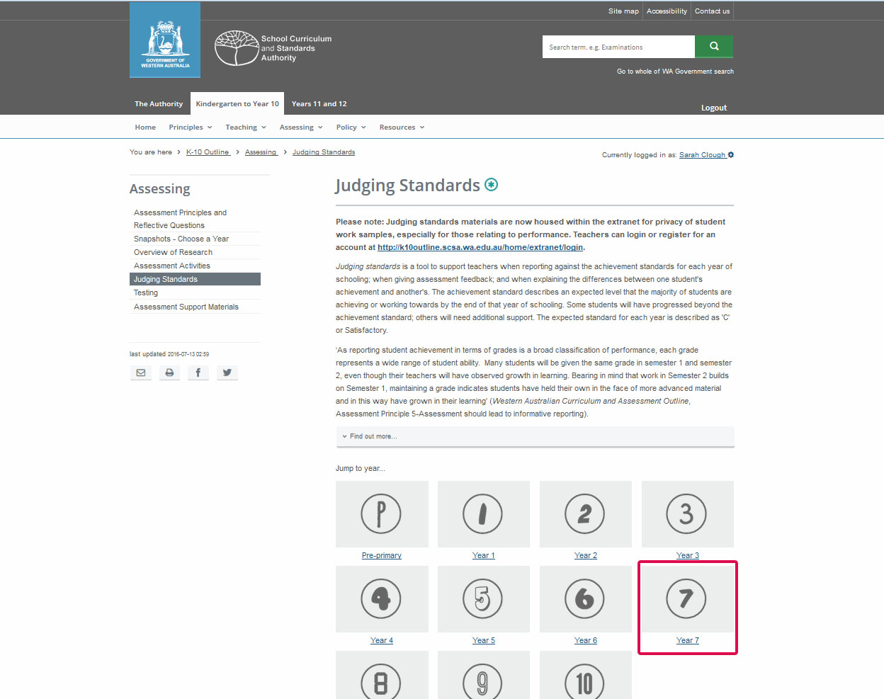

Slide 31
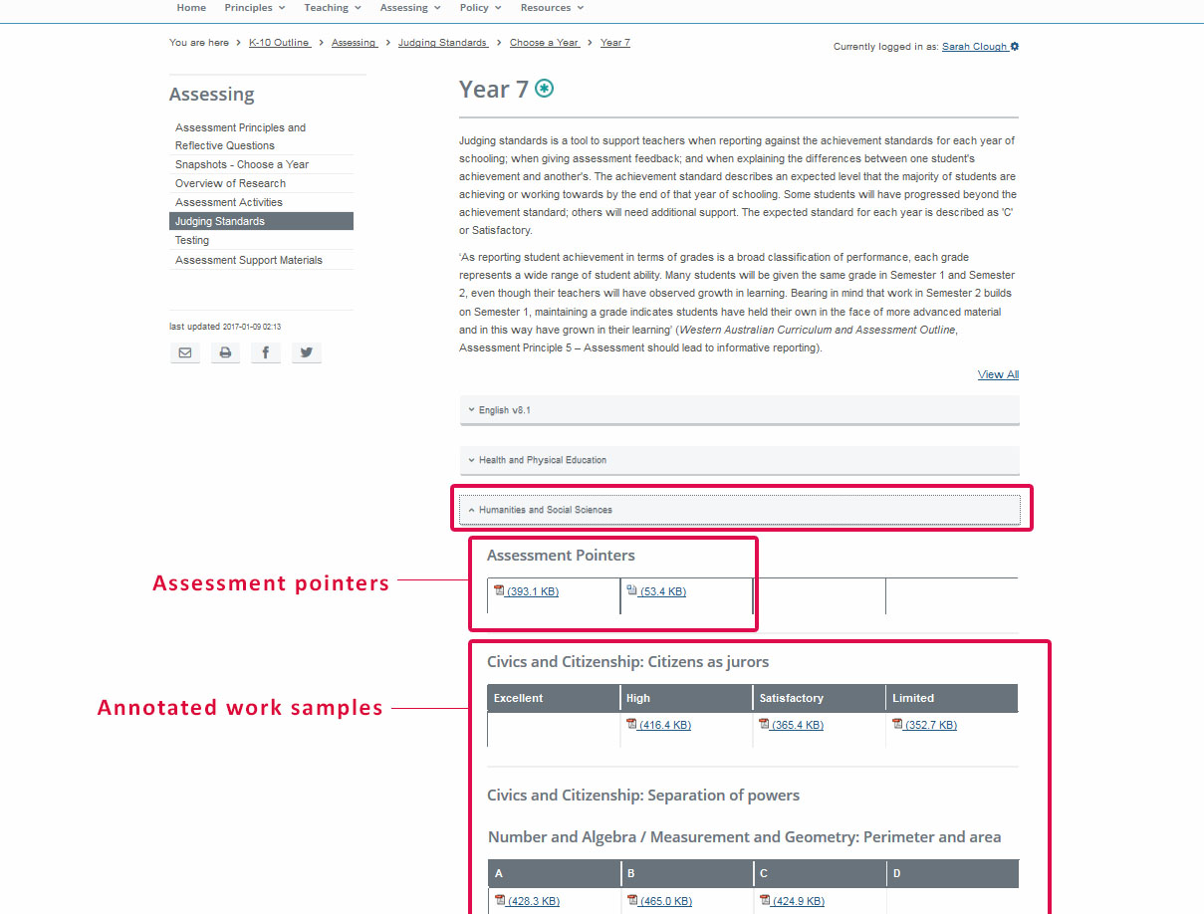

Slide 32
Assign a grade
Judging standards is a tool to support teachers when reporting against the achievement standards for each year of schooling; when giving assessment feedback; and when explaining the differences between one student's achievement and another's.
The grade is derived from the evidence collected across all the assessment tasks, both formative and summative.

Slide 33
The teaching, learning and assessment process
STEP 2
Plan for assessment
SCSA
Ways, and principles, of assessment
Develop assessment tasks and
marking keys
STEP 1
School
SCSA
STEP 3
Establish content to be taught
Assessment policy and assessment
plans
Assessment support materials
SCSA
Western Australian Curriculum and Assessment Outline
School
Teaching and learning programs
School
Assessment tasks
and marking keys
START
STEP 6
Common understandings
Assign a grade for reporting
School
SCSA
Student assessment
records
Principles of teaching, learning and assessment
Policy Standards for Pre-primary to Year 10: Teaching, Assessing and Reporting
Judging Standards
SCSA
Pre-Primary to Year 10: Assessment and Reporting Policy
Administer and mark assessment tasks
School
School
STEP 4
School report
SCSA
Record results and collate
evidence
STEP 5

Slide 34
Using the K-10 outline website to plan what to teach, assess and report
 | Teacher support material | Located on the website at:
Teaching | Principles of teaching, learning and assessment | Principles/Guiding Principles
 | Ways of teaching | Teaching/Overview
 | Ways of teaching video | Teaching/Overview
 | Sample teaching and learning outlines | Teaching/Teaching Support Materials
Assessing | Ways of assessing | Teaching/Overview
 | Sample assessment activities | Assessing/Assessment Activities
 | Assessment principles | Assessing
 | Assessment Snapshots | Assessing
 | Judging Standards Materials | Assessing/Login via the extranet
Policy | Policy Standards for Pre-primary to Year 10: Teaching, Assessing and Reporting | Policy

Slide 35
Mandy Hudson
Manager, Curriculum and Assessment
School Curriculum and Standards Authority
9273 6755
Mandy.Hudson@scsa.wa.edu.au

