Slide 1
Deputy Principals and Administrators Briefing
Years 7 to 10 and WACE
Meeting 2018 requirements

Slide 2
Years 7 to 10 update

Slide 3
P–10: Teaching, Assessing and Reporting Policy
https://k10outline.scsa.wa.edu.au/home/policy/teaching-assessing-and-reporting-policy
Notes:
The Pre-primary to Year 10: Teaching, Assessing and Reporting Policy and Policy Standards sets out the mandated requirements for Pre-primary to Year 10 (in the same way the WACE Manual sets out the requirements for Years 11 and 12).
The Western Australian Curriculum and Assessment Outline will be fully implemented in 2018 with the introduction of the Technologies, the Arts and Languages (staggered implementation) learning areas.

Slide 4
The teaching, learning and assessment process
Notes:
Highlights the interconnection between the curriculum, developing teaching and learning activities, linking assessment to the curriculum and reflective teaching practice, and collecting evidence for reporting and assigning a grade using the evidence collected.

Slide 5
What is mandated?
Curriculum content
Achievement standards
Principles of Teaching, Learning and Assessment
Reporting student achievement
Notes:
The Western Australian Curriculum and Assessment Outline (the Outline) sets out the knowledge, understandings, skills, values and attitudes that students in Pre-primary to Year 10 are expected to acquire and guidelines for the assessment of student achievement.
The Outline also contains: Guiding Principles for Western Australian schools for teaching, learning and assessment, the Pre-primary to Year 10: Teaching, Assessing and Reporting Policy and Judging Standards materials.

Slide 6
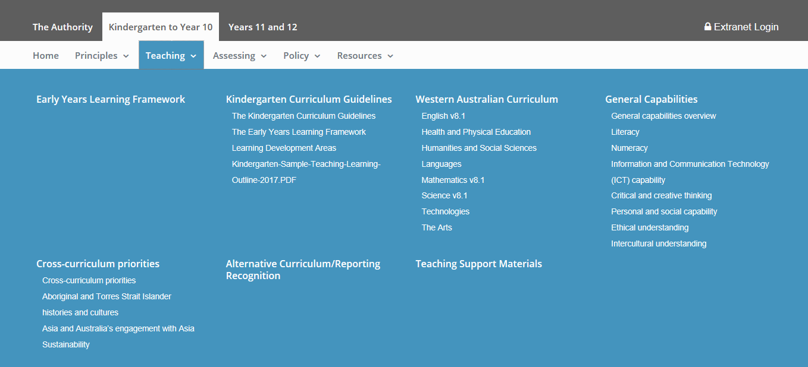
Notes:
The Western Australian Curriculum and Assessment Outline (the Outline) sets out the mandated curriculum for the eight learning areas in Western Australian schools.
Western Australia has taken as is the curriculum for English, Mathematics and Science (reflects v8.1 of the Australian Curriculum) and has adopted and adapted the Australian Curriculum for Humanities and Social Sciences, Health and Physical Education, Technologies, The Arts and Languages to meet the needs of Western Australian teachers and students. The achievement standards in the Western Australian Curriculum are what schools report against. Western Australia has developed the achievement standards for Humanities and Social Sciences, Health and Physical Education, Technologies, The Arts and Languages and modified the Australian Curriculum Achievement Standards for English, Mathematics and Science as part of the revision of the Judging Standards materials to reflect v8.1 of the Australian Curriculum.
The sample teaching and learning outlines exemplify the elements of a teaching and learning program (timing and sequencing, range of learning experiences through which students can apply the knowledge, skills and concepts from the syllabus content, the selection of resources to support teaching and learning experiences and the implementation of the principles of teaching and learning).

Slide 7
Implementing curriculum
5.1 Curriculum
Schools will implement the Pre-primary to Year 10 Western Australian Curriculum in accordance with:
the Policy Standards for Pre-primary to Year 10: Teaching, Assessing and Reporting
the Principles of Teaching, Learning and Assessment detailed within the Outline.
Pre-primary to Year 10: Teaching, Assessing and Reporting Policy p. 3
Notes:
The Western Australian Curriculum is mandated as are the principles of teaching, learning and assessment.
Schools must use the Western Australian curriculum as it has been adopted and adapted from the Australian Curriculum – it is not an exact match.

Slide 8
Mandated content
Notes:
The symbols identify whether the content is mandated (the exclamation mark) or teacher support materials (the asterisks).
The Guiding Principles are informed by the Melbourne Declaration on Educational Goals for Young Australians and the Australian Curriculum. The Guiding Principles for Western Australian Schools promote equity and excellence in Western Australian schools.
The principles of teaching, learning and assessment should be considered when developing teaching and learning programs and assessment plans.

Slide 9
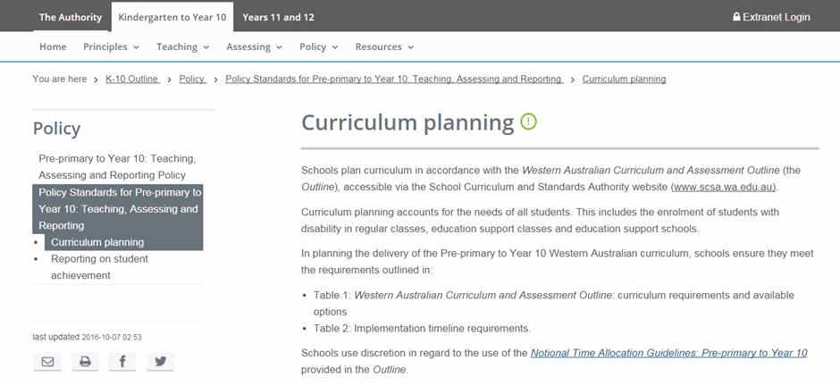
https://k10outline.scsa.wa.edu.au/home/policy/policy-standards/curriculum-planning
Notes:
The location of the Notional Time Allocation Guidelines: Pre-primary to Year 10 (the Guidelines).

Slide 10
Notional times
The guidelines have been developed to assist schools and teachers plan for and make decisions about how the curriculum is implemented in their schools.
Notes:
The Notional Time Allocation Guidelines: Pre-primary to Year 10 (the Guidelines) are presented as a guide. They are not mandatory and do not presume how schools should organise their students’ learning. They reflect the minimum time required to teach the mandated curriculum.
As outlined in the Authority’s Pre-primary to Year 10: Teaching, Assessing and Reporting Policy, there is an expectation that students will be provided with learning opportunities in all learning areas with provision for increased levels of specialisation in Year 9 and Year 10.
The notional hours in Table 1 assume a 25 hour teaching week over 40 teaching weeks. Note the unallocated time to provide for flexibility.

Slide 11
Assessment
5.2 Assessment
Schools will monitor and assess individual student achievement referring to the Principles of Teaching, Learning and Assessment detailed within the Outline.
Schools must provide their school community with an assessment and reporting policy that is based on the Principles of Teaching, Learning and Assessment.
Pre-primary to Year 10: Teaching, Assessing and Reporting Policy p. 3
Notes:
Pages 3 and 4 of the policy provide the specific requirements for schools.
Schools must have an assessment policy for 7 to 12 or 7 to 10 and 11 to 12

Slide 12
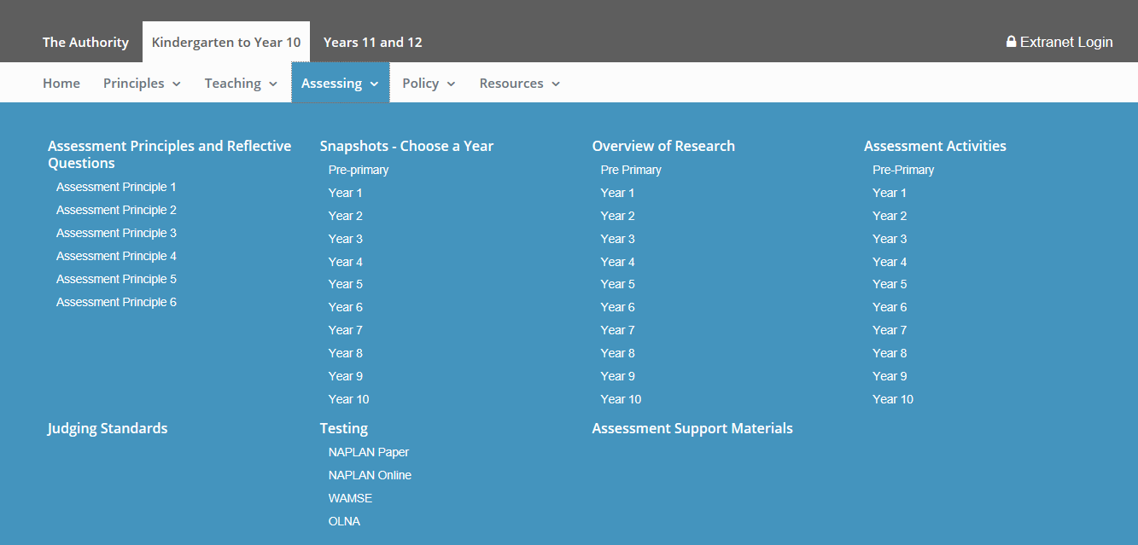
Notes:
A breadth of assessment resources from the mandated assessment principles to the teacher support materials including the Judging Standards materials which are a key focus.
Assessment snapshots illustrate the assessment principles within a classroom or school context.
Assessment activities employ a broad range of strategies teachers employ to obtain information about their students’ skills and understandings, and range from asking questions during a lesson to giving a formal standardises assessment. The activities reflect the principles of assessment.
Judging Standards is a tool to support teachers when reporting against the achievement standard; giving assessment feedback; and explaining the difference between one student’s achievement and another’s.
As with the sample teaching and learning outlines, the sample assessment tasks should be seen as a resource to develop school based resources, reflecting the context of the school. An assessment template is on the website for use – don’t have to use it but it covers the essential components to consider when developing assessment tasks.

Slide 13
Assessment tasks
‘Schools will develop and administer assessments in relation to the content of the Pre-primary to Year 10 Western Australian Curriculum.’
Assessment, Policy Standards for Pre-primary to Year 10: Teaching, Assessing and Reporting, 5.2
Assessment tasks provide:
a comprehensive sampling of the syllabus content
clear instructions on what is to be done, the conduct and completion of the task
opportunities for the full range of student achievement.
Notes:
Assessment needs to be comprehensive and balanced across various domains of learning and assess knowledge and higher order cognitive skills such as problem solving and critical thinking. Assessments need to be aligned with the curriculum and use a variety of assessment strategies, on the basis of their relevance to the knowledge, skills and understanding to be assessed and the purpose of the assessment.
Assessment is a comprehensive sampling of the mandated curriculum. Not all content has to be assessed.

Slide 14
Reflective questions
Do your assessments have a clear purpose?
How do you use your observation of students (during the course of classroom activities, in assignments and tests) to determine how learning can be improved?
How do you identify the next skill or understanding a student, or a group of students, needs to learn?
How do you work with colleagues to evaluate student achievement data and how does this work to inform your teaching?
Notes:
Reflective questions complement the principles of assessment contained in the Western Australian Curriculum and Assessment Outline. The assessment principles, reflective questions and assessment snapshots support teachers in reflecting on their own assessment practice in relation to each of the assessment principles.
The ‘ways of assessing’ were developed for all Phase 2 and 3 learning areas, and is located in the learning area overview. The ways of assessing for English, Mathematics and Science will be developed in 2018 in conjunction with teachers.
Refer to the Western Australian Curriculum and Assessment Outline (http://k10outline.scsa.wa.edu.au) for guidance on assessment principles and practices.

Slide 15
Analytical marking keys
‘Assessment criteria should be made explicit to students to focus their attention on what they have to achieve and provide students with feedback about their progress.’
Assessment Principle 2, assessment should be educative
Develop the marking key:
with the assessment task
to provide feedback to students
to ensure the fair and valid ranking of student achievement/performance.
Notes:
Analytical marking key: states what the task is, breaks down the components of the task, and assigns explicit criteria used to award marks. Each of the sample assessment tasks on the Authority’s website provides an analytical marking key.
It is important the judgements of student achievement are reliable. A marking key helps to ensure a consistent interpretation of the criteria that guide the awarding of marks.

Slide 16
Achievement standards
The achievement standards articulated in the Outline describe the expected achievement for students who have been taught the curriculum content for the full year of schooling.
Notes:
The Achievement Standards can be found in the syllabus for each year in the Western Australian Curriculum and Assessment Outline or in the Judging Standards for each year/learning area.
Reporting is not just a template but a timeline and process, established assessment plans and conversations that have taken place so staff can manage the process. Templates can be adjusted.
Key considerations to reinforce:
all of the curriculum is mandated to be taught but not all curriculum needs to be assessed (a comprehensive sampling)
a range of assessment strategies (not all timed, written tasks or tests).

Slide 17
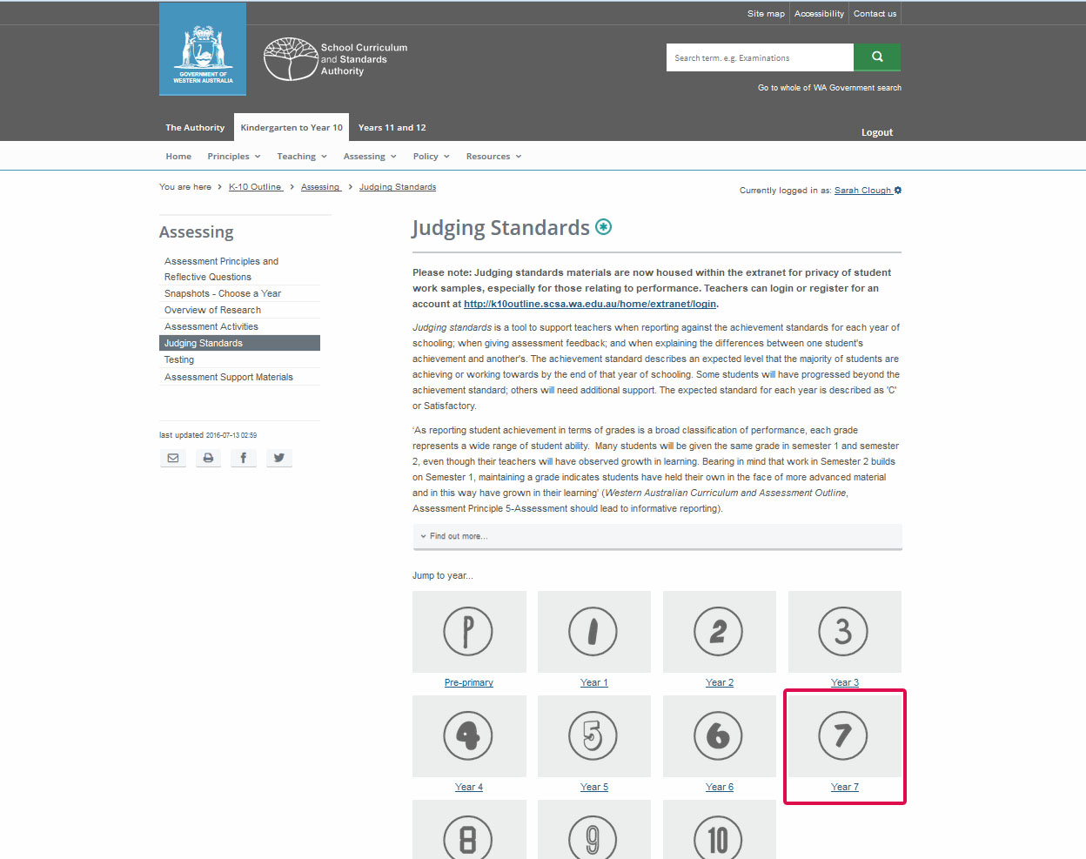
Notes:
EXTRANET - need to login to access Judging Standards materials.
Judging standards is seen as the core resource to support teacher judgement of student performance.

Slide 18
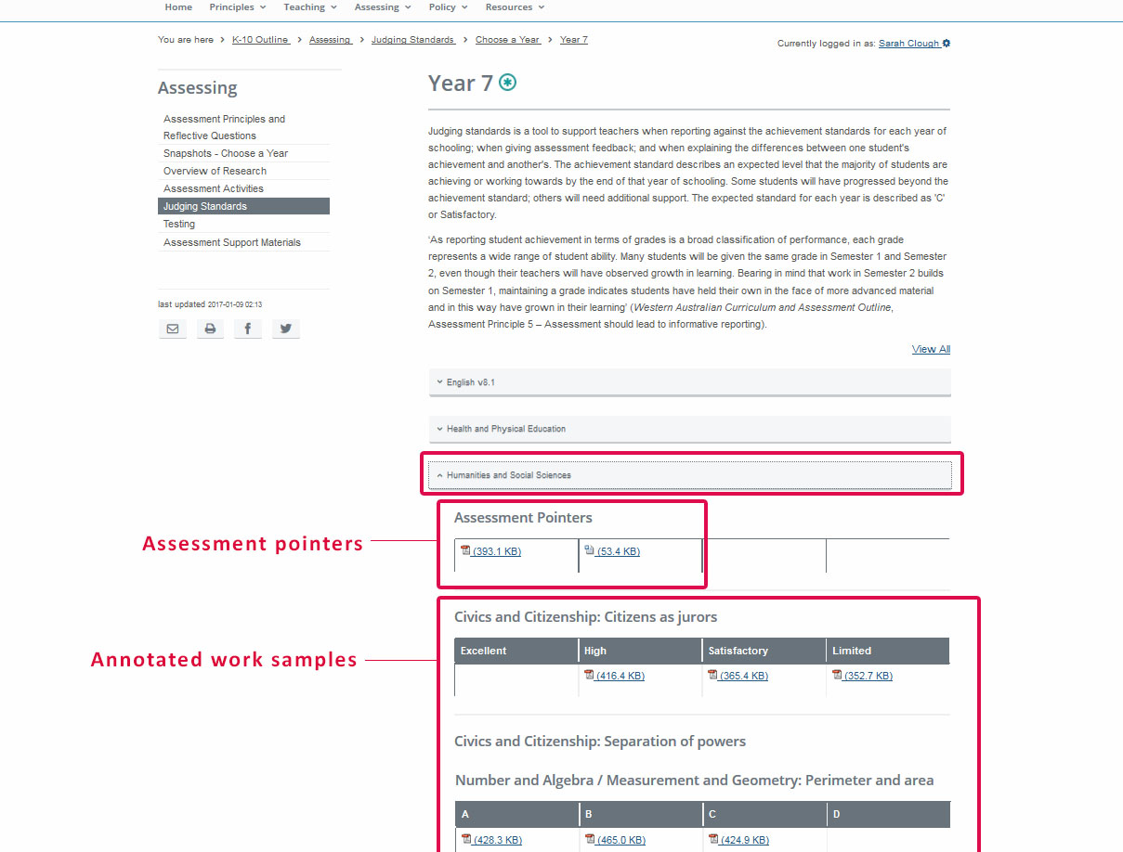
Notes:
Two parts to judging standards
assessment pointers
annotated work sample.

Slide 19
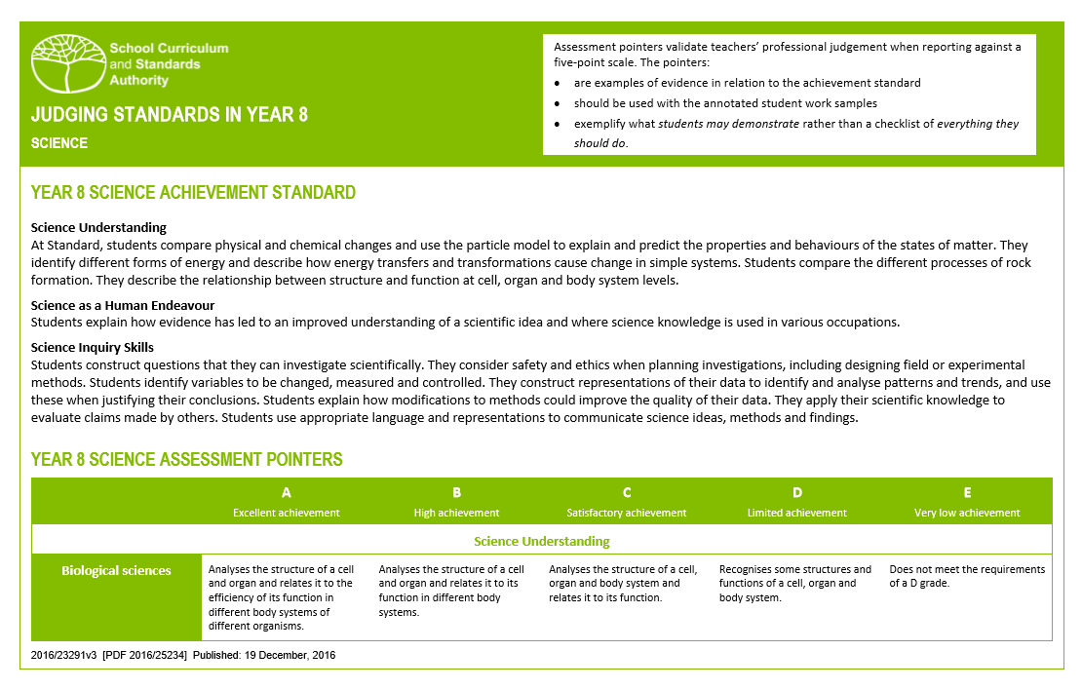
Notes:
Grades, and or achievement descriptions: for describing student achievement for the purpose of reporting. Grades, and/or achievement descriptions, are not assigned for individual pieces of work. WA designed based on evidence…multitude of authentic samples and input/validation from teachers.
Judging standards is a tool to support teachers when reporting against the achievement standards for each year of schooling; when giving assessment feedback; and when explaining the differences between one student's achievement and another's. The achievement standard describes an expected level that the majority of students are achieving or working towards by the end of that year of schooling. Some students will have progressed beyond the achievement standard; others will need additional support. The expected standard for each year is described as 'C' or Satisfactory.
Assessment pointers: for validating teachers’ professional judgement when reporting against a five-point scale. The pointers are examples of evidence in relation to the achievement standard; should be used with the annotated work samples; and, exemplify what students may demonstrate rather than a checklist of everything they should do. In some learning areas, depending on what has been taught in the reporting period, teachers may refer to only a selection of the pointers in one or more of the subjects and/or contexts of the learning area.

Slide 21
Annotated Work Samples
Are used for:
supporting teachers when reporting against the Achievement Standard
explaining the differences between one student’s achievement and another’s
implementing internal moderation practices.
Notes:
Annotated work samples: for supporting teachers when reporting against the achievement standard; when explaining the differences between one student’s achievement and another’s; and, in implementing internal moderation practices. ‘Moderation for Reporting’ focuses on those aspects of assessment where schools are required to be accountable for student performance and where it is important that teacher judgements are comparable. When undertaking moderation for reporting purposes, the emphasis is on broad classifications of student performance (e.g. reporting student performance in terms of grades or in terms of achieving the standard), and ensuring teachers have consistent interpretations of these broad classifications (Western Australian Curriculum and Assessment Outline, Assessment Principle 5-Assessment should lead to informative reporting).

Slide 22
Notes:
The sample online breaks the image down into smaller sections with additional annotations to highlight artistic processes and style.
Black text reflects the assessment pointers.
The purple text is the evidence relating to the assessment pointer identified in this particular sample.

Slide 23
Reporting
2.1 Reporting on student achievement
Schools will provide plain language reports to parents/carers at the end of each semester which:
give an accurate and objective assessment of the student’s progress and achievement
include an assessment of the student’s achievement in terms of the Western Australian achievement standards detailed in the Outline
include for the subjects studied, an assessment of the student’s achievement in terms of the grades
Policy Standards for Pre-primary to Year 10: Teaching, Assessing and Reporting p.11
Notes:
Policy supported by the standards which provide guidance for the school.
Policy standards are embedded in the policy document on the Authority’s web site articulating expectations.

Slide 24
Reporting – minimum requirements
Notes:
Schools need a clearly defined strategy for what will be reported (e.g. strands, sub-strands) and the implications for assessment?
Reporting is not just a template but a timeline and process, established assessment plans and conversations that have taken place so staff can manage the process. Templates can be adjusted.
Key considerations :
all of the curriculum is mandated to be taught but not all curriculum needs to be assessed (a comprehensive sampling)
a range of assessment strategies (not all timed, written tasks or tests).

Slide 25
Clarifying reporting
Schools report a learning area grade or in more detail (i.e. in strands/sub-strands)
A Semester 1 grade and an end of year grade (i.e. the whole year’s work)
There no set weightings for strands/sub-strands that contribute to the grade
How do you report against the year level achievement standard in a ‘streamed class’ or multi-age grouping?
Notes:
Conceptual understanding of the learning area to determine the best way to report referring back to the rationale/organisation for the learning area.
Reporting against the achievement standards which are based on development over the year (not the semester). As stated in the policy for mid-year reporting, teachers make a professional judgement regarding the level of achievement that the student is demonstrating relative to the achievement standard, taking into account the curriculum that has been taught and assessed to that point in time.
All students have the opportunity to demonstrate their learning against the content and achievement standard for that year level.

Slide 26
IMPLEMENTATION UPDATE

Slide 27
Technologies and The Arts
The Western Australian Curriculum for Technologies and The Arts is mandated for students:
in Pre-primary to Year 8 and
in Years 9 and 10 who specialise in these subjects.

Slide 28
Technologies
The Technologies curriculum is written on the basis that all students will study both Technologies subjects from Pre-primary to Year 8:
Design and Technologies
Students have the opportunity to study at least one context
Digital Technologies.
Notes:
Design and technologies contexts
Engineering principles and systems;
Food and fibre production;
Food specialisations;
Materials and technologies specialisations
In design and technologies, it is desirable that schools provide students with the opportunity to engage with all four contexts across Pre-primary to Year 8.
Digital technologies does not have contexts.

Slide 29
The Arts
The Arts curriculum is written on the basis that all students will study at least two Arts subjects from Pre-primary to the end of Year 8.
It is a requirement that students study:
a performance subject (Dance, Drama, Music) and
a visual subject (Media Arts, Visual Arts).
Notes:
In the Arts, it is desirable that schools provide students with the opportunity to engage with all five Arts subjects across Pre-primary to Year 8.

Slide 30
Languages
The Languages curriculum is mandated for students in Year 3 to Year 8, and for students specialising in a language in Years 9 and 10
staggered implementation to support resourcing
schools should maintain existing language programs
implementation for Year 7 is scheduled for 2022
Notes:
The Authority has developed six second languages syllabuses.
Languages has a staggered implementation commencing with Year 3 in 2018.
In the interim, familiarisation with the syllabus and resources should be the focus of planning.
With the staggered implementation for Languages, students entering Year 7 in 2022 will enter secondary schooling with a language learning background.
The Authority is currently working with schools to develop a document to provide schools with the building blocks required for students beginning a different language in Year 7 to that learnt in primary school.

Slide 31
Alternative languages
Schools may offer a language other than those for which syllabuses are provided by the Authority using ACARA's curriculum.
Notes:
Schools may offer a language other than those for which syllabuses are provided by the Authority using ACARA's curriculum or a language curriculum approved by the Authority. Schools will need to apply for alternative curriculum recognition as per Policy Standards for Pre-primary to Year 10: Teaching, Assessing and Reporting page 8.
The study of Auslan is appropriate.

Slide 32
Senior school update

Slide 33
Senior schooling update
Moderation update
What’s New?
WACE Manual 2018
Notes:
Moderation update
Consensus moderation 2017/18
Syllabus Delivery Audit 2017/18
EST 2017/18 purpose and analysis
ATAR analysis
What’s new
Non approval of grades
Change to Foundation eligibility process
WACE checker
WACE Manual update
Retention of student work
Unit completion
Allocation of grade cut-offs

Slide 34
moderation

Slide 35
Consensus Moderation 2017
8 General courses for Year 11 and 12, and one Foundation course for Year 11 only
140 meetings of which 117 were metropolitan meetings and 23 were regional meetings
1421 teachers participated
Feedback provided indicated that teachers value the consensus moderation process and the opportunity to discuss marking and assessment practices

Slide 36
Year 12 ATAR courses identified for 2018
Applied Information Technology
Chemistry
English
Mathematics Applications
Mathematics Methods
Media Production and Analysis
Modern History
Music
Philosophy and Ethics
Physical Education Studies
Politics and Law
Visual Arts
Notes:
Consensus moderation in 2018 will be conducted for Year 12 ATAR courses only, to support the SDA (Year 12 ATAR in 2018) and for some Year 12 General courses that were not included in the 2017 consensus moderation process.

Slide 37
Year 12 General courses identified for 2018
Automotive Engineering and Technology
Building and Construction
Drama
Integrated Science
Religion and Life
Notes:
Consensus moderation in 2018 will be conducted for Year 12 ATAR courses only, to support the SDA (Year 12 ATAR in 2018) and for some Year 12 General courses that were not included in the 2017 consensus moderation process.

Slide 38
Syllabus Delivery Audit (SDA)
Year 11 ATAR 2017 key findings
for your school
for the Authority
Implications for your school for 12 ATAR 2018
Actions for the Authority
Notes:
Access to SDA reports is through SIRS2
School reports DOA005 (returned to schools late March) to be distributed to HOLA’s/teachers for action asap.
Feedback to Authority during grading reviews – Teachers and HoLAs often have not seen the report.
SDA protects you from student appeals based on documentation not meeting the requirements e.g. alignment of both outlines to each other

Slide 39
DOA005
Notes:
Implications of these and what conversation you would have with the relevant HoLA
E.g. revise the assessment outline to remove assessment of content that is not in the current syllabus
E.g. revise the assessment outline to include a comprehensive sampling of the syllabus content
New for 2018:
Information for the teacher pages 21-22 of SDA 2018 handbook – provides explanatory notes of possible non-compliance issues for teachers attention.
Work through these, speak with HOLA and only contact Principal Consultant if still unsure of issue.
NOTE: new/altered documents must be re-distributed to students but do not need to be sent to the Authority
The SDA is seen by the Authority as a collection of data that may contribute toward a grading review and possible non-approval of grades. E.g. if the school submits for a course a direct copy of the Authority’s sample documents with no refinements this is of concern.

Slide 40
Externally set task (EST)

Slide 41
EST reports in SIRS
EST010 | A scatter graph on which each school is shown by plotting the school mean mark against the reviewer mean mark for the selected scripts. A guide to reading the 2017 EST Scatter graphs is available as part of the EST010 report. (15% tolerance)
EST011 | A list showing by class the school mark and the reviewer mark for each selected script, the means of these marks and the difference between the means.
EST013 | A ranked list by class of the mark submitted for each student and the reviewer mark for selected scripts.
EST014* | A graph of the state mark distribution vs the school mark distribution (for students selected and not selected to be externally marked).
EST017* | A breakdown of reviewer marks by question/section for each selected student for each EST.

Slide 42
Mean comparison
Notes:
EST010:
Useful for checking comparative performance against state or internally across contexts
The tolerances for 2018 will drop from 15% to 10%
For the second graph in this course there is a significant group of schools where the school interpretation of standards is apparently higher than the interpretation of the markers. This statewide pattern deserves investigation. Possible reasons could be that there is still
a hangover of Stage 1 standards being applied
Course content dot points are interpreted too simplistically e.g. in some Foundation courses
Possible solutions for schools would be to review the samples provided on Authority website, also review the sample tasks provided online and examine the language of the course grade descriptions
NOTE if the aberrant grouping in graph two was the opposite i.e teachers marking too hard what could be a suggested reason? Interestingly this can happen in subjects where ATAR and General students are combined in the same class. There can be a tendency for teachers to judge students against the ATAR course expectations rather than the General expectations

Slide 43
EST011 – school mark v SCSA reviewer mark
Notes:
Compare class to class.
Lines of Inquiry:
Differences between classes in relation to external marker parity?
What were the internal moderation processes for marking?
Why was the pattern of class with four outside tolerance samples all significantly higher than the external marker?

Slide 44
EST014 school mark frequency
Notes:
Implications for Deputy Principal discussions when working with HoLAs:
Does the school pattern reflect the school understanding of the student capabilities?
Does the school pattern reflect the school expectation of proposed grades?
What possible reasons are there for the school population fitting where it does in the state pattern? Possible reasons could be the nature of the students, demand pitch of tasks delivered against the content dot points, misinterpretation of demand of content …… but it is useful to think and inquire for possible reasons

Slide 45
Reflective questions
How do the other school assessment tasks and marking keys align with the pitch of the EST?
What quality of assurance does the EST data provide about the school allocation of grades and decisions about grade cut-offs?
To what extent does the EST data inform the future focus, pitch and nature of course content delivery?
What observations can be made about internal comparability where more than one teacher is delivering the course?
Notes:
Post EST schools received reports related to the EST - these reports would inform the engagement with these broader reflective questions that were included with the letter to your principal on the use of the reports
Using the feedback in the reports
The reports provide useful data for schools related to:
understanding by teachers of standards and the pitch and demands of course content
comparisons of school performance against the rest of the State cohort
internal performance comparisons between classes.
Note: schools are advised to use the data in the reports cautiously as it relates to a single, limited assessment.
Lines of inquiry include exploration of:
school patterns of final scores outside the tolerances for the course (EST010)
class-by-class patterns of final scores outside the tolerance for a course (EST011)
patterns of relative student performance by item or question within a test.

Slide 46
atar

Slide 47
ATAR reports in SIRS
STS036 | A graphical representation of each schools marks in relation to state-wide school marks
STS022 | A breakdown of enrolment and examination numbers, statistical moderation of school marks, small group moderation, grade distribution, ATAR course examination marks and school marks and individual student achievement
STS028 | A graphical representation of the school grade allocations and the state grade allocations for a course with reference to either the moderated school mark or the ATAR course examinations mark distribution
Detailed examination feedback | Maximising feedback
Notes:
SIRS reports available to all schools for all ATAR courses. Your system/sector may provide you with generated/summary reports but your HoLAs should be provided with access to these reports also.
These reports provide detailed information on student performance against the course (without scaling)

Slide 48
STS036
Notes:
SIRS Report (STS036) provides an indication of the comparability of your school results to exam results and to state exam performance by graph and table.
This report should open lines of enquiry for your HoLAs related to:
appropriate coverage of syllabus
scope of assessment outline
quality and pitch of assessment tasks
review by teachers of changes or adaptions to course delivery and assessment from previous year
examination readiness as a cohort

Slide 49
STS022
Notes:
Previous slide can be further supported by the information in SIRS report STS022 which summarises the key statistics for a selected school, for a selected course.
The report has 11 sections.

Slide 50
STS022
Notes:
Section 10:
Key things to note about this table are that
the mean raw exam mark for the school is no longer standardised
the mean statistically moderated school mark for the school is also not standardised so the shape of the distribution curve will reflect the shape of the exam distribution curve (not a normal bell shaped curve)
The course combined score gives an opportunity for teachers to reflect on how students achieved against the content of the course
The only time scores are standardised to a bell shaped curve (with a Mean = 60%, s.d = 13.5%) is for the mean standardised score for the school (this is used by TISC in the calculation of the ATAR for university entry).
Note: the statistical moderation of school marks preserves the ranking of school marks for a course in a particular school. The examination is the ‘common’ assessment task for all the Year 12 ATAR students in a course that provides for the adjustment of school marks for comparability.
Courses with practical component
same except for course combined score
Last step in the process where component combined written mark and component combined practical mark are averaged to generate a course combined score

Slide 51
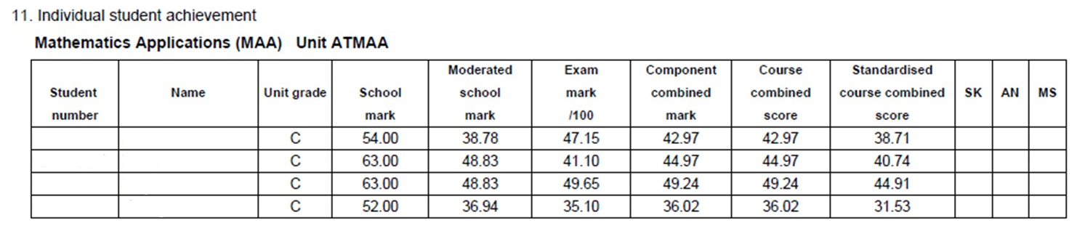
STS022
Notes:
Section 11: same data for each individual student
Different students will be statistically moderated different amounts.
Rank order very important – a student under/over performs may be dragged down/up and have impact on those around him.
Teachers should be aware that under-performance or over-performance can be catastrophic for small groups.
HOLAs/teachers need to ensure that the tasks created in each learning area discriminate to determine this ranking accurately.
Encourage students to maintain best performance all year, not just during the exam.

Slide 52
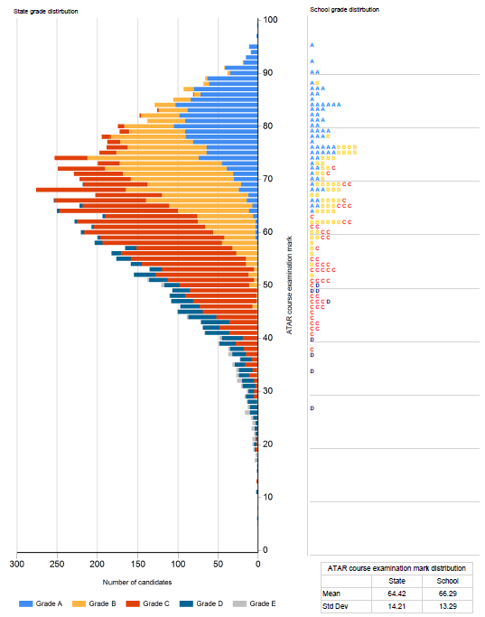
STS028
Notes:
STS028 (a new version of this report, significantly revised from previous years) shows the grade distribution against:
Raw examination score or
Moderated school mark for each course for all schools
This slide shows two schools where students examination marks are compared against their grades and the state pattern
STS028 is useful for raising discussions on:
elements within a grade description
balance of what’s important in a grade description
developing assessment and marking keys that provide information to support grading decisions
Review of the collective pitch of assessment tasks to support accurate grading of student portfolios
As a school you can see the distribution of your awarded grades against raw examination or moderated school mark.
An opportunity to review understandings of A-E grade descriptions against state wide understandings.
Note: some students do not perform at the same standard in the ATAR examination as in tasks at school which can measure a broader range of learning over an extended period of time. However, typically, students who are assigned an A grade would be expected to be in that area of the graph.
Bunching of A/B/C’s may indicate lack of higher order tasks to discriminate between students

Slide 53
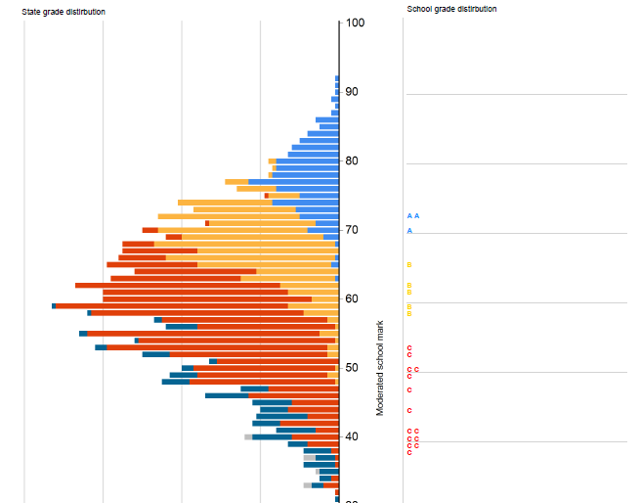
STS028
Notes:
The previous slide displayed student grades mapped against their raw mark in the exam. This second graph which is part of STS028 displays the students grades against their moderated school mark and compares it with the moderated school mark and grades mapped for all the students doing the course across the state. This school displays a pattern which is slightly displaced against the state pattern for allocation of grades. It is interesting but not necessarily related that the difference between the state and the school mean is 8.03 marks which is similar to the difference in the school’s pattern for grades against the state pattern for grades.

Slide 54
What’s new

Slide 55
Non-approval of grades

Slide 56
Board Resolution – 27 June 2017
Rejection of grades
The Board noted the feedback from the Secondary Principals’ Advisory Committee regarding the non-approval of grades under the approved grading review process (approved at the November 2016 Board meeting – resolution 77/16).
Resolution 48/17
The Board approved the proposal to amend the Grade Approval Process for 2017.
Notes:
Drivers for this are a small minority of schools who are:
not delivering content
not grading students against the standards used and followed by other schools in the state.
This applies particularly to schools following a ‘Deep C’ practice
NOTE – This is not meant to be a process for marginal cases about cut off points.
The Authority has separate processes for that which involve conversations between Principal Consultants and HoLAs
Resolution 48/17
The Board approved the proposal to amend the Grade Approval Process for 2017:
specifically to postpone for 12 months the potential rejection of Year 12 grades, and instead issue a ‘Notice of Intent’ to the principal of a school where the non-approval of grades was highly likely.
The Authority will provide further clarification of this process and timeline to school leadership teams and teachers.

Slide 57
Non-Approval of Grades
2018 Pilot year for process with Year 12
Follow-up from grading reviews
Proposed/final grades -vs- grading review advice
Consequences and implications for the WACE
2019 formal use of Notices of Intent
Notes:
Following school visits, the Authority expects schools to align assessments and grading with advice provided to schools on suggested cut-points for grades.
When schools submit their proposed grades and do not follow advice provided at the visit then schools will need to provide a detailed explanation with justification why the advice has not been followed.
Schools will need to retain their records and have access to student work at short notice if the Authority chooses to revisit the school.
Follow-up visits to the school will involve the Authority’s course Principal Consultant and an independent moderator such as the Chair of the Course Advisory Committee.
The implications of this could include that the Authority will not accept the school’s grades for that course in 2019. Principals will be advised in 2018 if grades would not have been accepted.
Non-approval of school results will impact both the WASSA and the achievement of the WACE for students.

Slide 58
Non-Approval of Grades – Process and notice
Process
Critical role of all school visits and school preparation
Fairness … prior warning and due process
Update School Assessment Policy re: student work retention
Notice of Intent
Responsibility to inform students/parents of implications
Brief turnaround time
Notes:
The role of deputy principals/senior administrators in ensuring these points are actioned:
Further visits indicate an unresolved issue that could impact seriously on the approval of students’ grades
Ensure that all paperwork and evidence is ready and ‘talks to each other’ e.g. teacher’s marks spreadsheet headings correlate with assessment task outline. It will save a lot of follow up work for both the school and the Authority
Venue for visit is suitable for a quiet review of school samples and information
Teachers/HoLAs right of reply
Relevant Deputy Principal is available to meet with the Principal Consultant before and after the visit again this is required because of ‘possible non-approval of grades’
New for 2018 – requirement to record in raw marks not percentages in marks books/spreadsheets – may require changes to reporting systems

Slide 59
WACE Checker
Notes:
Exponential curve in students applying for Special Consideration.
Shifts awareness to students.

Slide 61
Wace manual update

Slide 62
Retention of student work – Option 1
The school establishes an assessment file for each student which:
contains all marked written assessment tasks, and can be accessed by the student for revision purposes
is retained by the school until the results are accepted by the Authority
is returned to the student within a specified period after the results are accepted by the Authority or is securely disposed of by the school.
2.8.2 WACE Manual 2018 p. 34
Notes:
Option 1 - School takes responsibility for retaining work.

Slide 63
Retention of student work – Option 2
The school does not physically retain students’ written work:
students are responsible for retaining all of their marked written assessment tasks
the School Assessment Policy advises students that the Authority may request access to student assessed work during the school year
non provision of assessed work by a student for the purpose of Authority grade validation or moderation processes may impact on the Authority approval of final grades.
2.8.2 WACE Manual 2018 p. 34
Notes:
Option 2 - Student takes responsibility for retaining work.
This has possible consequences for students and this MUST be spelt out in school assessment policy if school goes down this pathway

Slide 64
Unit completion and allocation of grades
Completion includes the ‘educational program’ and the ‘assessment program’
‘… reason for non-completion is acceptable … sufficient evidence is available … teacher can make a professional judgement.’
2.4.3 WACE Manual 2018 p. 18
Notes:
2.4.3 WACE Manual page 18 and diagram page 20
‘educational program’ requirement is why private candidature has been removed except for interstate languages
Professional judgement must
Reflect school assessment policy
Meet the chosen grade description
Not disadvantage/discriminate against the other students in cohort (fairness for work done)

Slide 65
Information about new rules for Foundation
Clarity about eligibility
Category 1 and 2
Two amendments
literacy affects access to List B Foundation
enrolment without OLNA completion
Notes:
Principal declaration on a case by case. There is no blanket sign off for a class.
An audit process is being prepared to monitor the Application for Exemption process.
In section 1.8 of the WACE Manual 2018 includes all the rules.
Also is referenced in eCircular for November 2017.
Category 3 students cannot apply for the exemption at end of year 10 going into year 11.
E-circular - ‘Schools will be able to apply for individual students to be enrolled in Foundation courses where the student is yet to sit either (NAPLAN) or the (OLNA), or where it would be educationally beneficial for the student to remain enrolled in a Foundation course for 2018.

Slide 66
Allocation of grade cut-offs
generate a ranked list of all students based on the weighted mark out of 100 using the school’s assessment outline
compare the work for selected students with the grade descriptions
identify from the ranked list a ‘gap’ in the marks
examine the work of the students either side of this point
determine the cut-offs
Notes:
The process is not about predetermined cut offs where above 75 is an A and above 50 is a C. Grades are allocated using grade descriptions.
New for 2018 WACE manual – requirement to record raw marks for each assessment task (not percentages) in the student assessment records (marks book)– may require changes to reporting systems. Section 2.8.2 WACE Manual 2018 (3.4.4) p. 42.
Proposed grades submitted to the Authority are the estimated grade for the student at the date of submission (30 August in 2017) NOT Semester 1 grades.

Slide 67
Final advice
WACE Manual 2018
Meeting deadlines in Activities Schedule
Check uploaded data
Assessment policy
eCirculars

