Slide 1
School Leader Briefing Secondary Term 1 2018
2017/66515v5

Slide 2
Acknowledgement
The Authority could not complete its work without teachers.
Through the support of Principals, the voices of classroom teachers are reflected in all aspects of the Authority’s work.

Slide 3
Purpose of Today
Western Australian Curriculum and Assessment Outline
Policy Requirements 7–10
2018 Year 7–10 Implementation
Western Australian Certificate of Education (WACE)
2017 WACE – statistics and review
WACE – 2018
Adjustments for Students
2018 – Communications and Processes

Slide 4
Western Australian CURRICULUM AND ASSESSMENT OUTLINE Policy Requirements Year 7–10

Slide 5
What is Mandated?
Curriculum content
Achievement standards
Principles of Teaching, Learning and Assessment
Reporting student achievement
Notes:
The Western Australian Curriculum and Assessment Outline (the Outline) sets out the knowledge, understandings, skills, values and attitudes that students in Pre-primary to Year 10 are expected to acquire and guidelines for the assessment of student achievement.
The Outline also contains: Guiding Principles for Western Australian schools for teaching, learning and assessment, the Pre-primary to Year 10: Teaching, Assessing and Reporting Policy and Judging Standards materials.
Teachers and administrators need to spend time to navigate and explore what is on the Authority’s website and what is available to teachers/schools to assist with the implementation of the Outline.

Slide 6
Notional Times (not mandated)
Guidelines developed to assist schools and teachers to plan for and make decisions about how the curriculum is implemented.
The curriculum is mandated; students need to be given adequate time in their timetable to cover the curriculum and allow for meaningful assessment.
*Learning areas not mandated after Year 8.
** ‘Unallocated time’ would actually be greater than shown, depending on the number of hours of teaching per week at each school.
Notes:
The Western Australian Curriculum is mandated. The Notional Time Allocation Guidelines: Pre-primary to Year 10 (the Guidelines) are presented as a guide. They are not mandatory and do not presume how schools should organise their students’ learning. They reflect the minimum time required to teach the mandated curriculum.
As outlined in the Authority’s Pre-primary to Year 10: Teaching, Assessing and Reporting Policy, there is an expectation that students will be provided with learning opportunities in all learning areas with provision for increased levels of specialisation in Year 9 and Year 10.
The notional hours in Table 1 assume a 25 hour teaching week over 40 teaching weeks.
Note the unallocated time to provide for flexibility.

Slide 7
Assessment
Assessments need to:
align with the curriculum
utilise a variety of strategies.
Schools must provide their school community with an assessment and reporting policy that is based on the Principles of Teaching, Learning and Assessment.
Pre-primary to Year 10: Teaching, Assessing and Reporting Policy p. 3
Notes:
Assessment is a comprehensive sampling of the mandated curriculum and should provide opportunities for the full range of student achievement. Not all content has to be assessed.

Slide 8
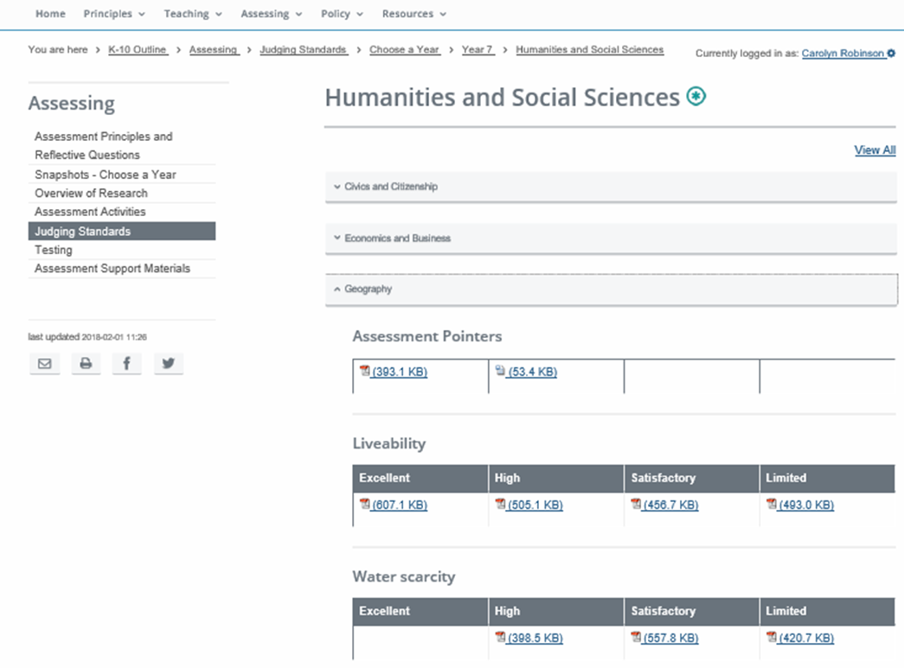
Achievement standards
The achievement standards articulated in the Outline describe the expected achievement for students who have been taught the curriculum content for the full year of schooling.
Notes:
The Achievement Standards can be found in the syllabus for each year in the Western Australian Curriculum and Assessment Outline or in the Judging Standards for each year/learning area.
Reporting is not just a template but a timeline and process, established assessment plans and conversations that have taken place so staff can manage the process. Templates can be adjusted.
Key considerations to reinforce:
all of the curriculum is mandated to be taught but not all curriculum needs to be assessed (a comprehensive sampling)
a range of assessment strategies (not all timed, written tasks or tests).

Slide 9
Assigning a Grade for Reporting
Judging standards is a tool to support teachers:
to report against the achievement standards for each year of schooling
to give feedback on assessment
to explain the difference between one student's achievement and another's.
The grade is derived from the evidence collected across all the assessment tasks, both formative and summative.

Slide 10
Reporting – Minimum Requirements
In the future, the Authority will require the final grade to be provided for each learning area as described in the reporting policy.
Pre-primary to Year 10: Teaching, Assessing and Reporting Policy p. 13
Notes:
Schools will:
use plain language to report to parents/carers on the achievements of Pre-primary to Year 10 students in terms of the Western Australian achievement standards – such reports will be provided:
formally, in an end of semester report using a five-point scale. The components of the formal report will meet the Policy Standards for Pre-primary to Year 10: Teaching, Assessing and Reporting
informally, throughout the year in a variety of ways and for a variety of reasons, and
as requested from the student’s parents/carers, providing information on how a student’s achievement compares with the student’s peer group at the school
disseminate to parents/carers the reports from national and state-wide assessments and, as appropriate, provide opportunity for discussion between teachers and parents/carers
submit to the Authority* end of Semester Two achievement descriptors/grades for individual Pre-primary to Year 10 students.
Note: Schools will be advised by the Authority about the timeline for submission of grades/achievement descriptors. If a subject/s is only taught in Semester One and not in Semester Two (e.g. a Visual Arts subject), the achievement descriptor/s/grade/s for individual Pre-primary to Year 10 students will be submitted to the Authority at the end of Semester Two.

Slide 11
Clarifying Reporting
Schools report a learning area grade or in more detail
i.e. in strands/sub-strands or modes.
A Semester 1 grade and an end of year grade
i.e. the whole year’s work.
There are no set weightings for strands/sub-strands or modes that contribute to the grade.
Consider your strategy to report against the year-level achievement standard in a ‘streamed class’ or multi-age grouping.
Notes:
Conceptual understanding of the learning area to determine the best way to report referring back to the rationale/organisation for the learning area.
Reporting against the achievement standards which are based on development over the year (not the semester). As stated in the policy for mid-year reporting, teachers make a professional judgement regarding the level of achievement that the student is demonstrating relative to the achievement standard, taking into account the curriculum that has been taught and assessed to that point in time.
All students have the opportunity to demonstrate their learning against the content and achievement standard for that year level.
School system/sectors devise own reporting schedules and reporting to parents formats.

Slide 12
2018 Year 7–10 Implementation

Slide 13
Implementation Requirements
2018 is the first year of full implementation for The Arts,
Technologies and Languages (Year 3).
The other learning areas are already fully implemented:
English
Mathematics
Science
Humanities and Social Sciences
Health and Physical Education.

Slide 14
Technologies
The Technologies curriculum is written on the basis that all students will study both Technologies subjects from Pre-primary to Year 8:
Design and Technologies
Students have the opportunity to study at least one context
Digital Technologies.
Notes:
The Western Australian Curriculum for Technologies is mandated for students:
in Pre-primary to Year 8
in Years 9 and 10, for those who choose to continue with these subjects.
Design and Technologies contexts:
Engineering principles and systems
Food and fibre production
Food specialisations
Materials and technologies specialisations.
In Design and Technologies, it is desirable that schools provide students with the opportunity to engage with all four contexts across Pre-primary to Year 8.
Digital Technologies does not have contexts.

Slide 15
The Arts
The Arts curriculum is written on the basis that all students will study at least two Arts subjects from Pre-primary to the end of Year 8.
It is a requirement that students study:
a performance subject (Dance, Drama, Music) and
a visual subject (Media Arts, Visual Arts).
Notes:
The Western Australian Curriculum for The Arts is mandated for students:
in Pre-primary to Year 8
in Years 9 and 10, for those who choose to continue with these subjects.
In the Arts, it is desirable that schools provide students with the opportunity to engage with all five Arts subjects across Pre-primary to Year 8.

Slide 16
Languages
The Languages curriculum is mandated for students in Year 3 to Year 8, and for students specialising in a language in Years 9 and 10:
staggered implementation to support resourcing
schools should maintain existing language programs
implementation for Year 7 is scheduled for 2022.
Notes:
The Authority has developed six second languages syllabuses.
Languages has a staggered implementation commencing with Year 3 in 2018.
In the interim, familiarisation with the syllabus and resources should be the focus of planning.
With the staggered implementation for Languages, students entering Year 7 in 2022 will enter secondary schooling with a language learning background.
The Authority is currently working with schools to develop a document to provide schools with the building blocks required for students beginning a different language in Year 7 to that learnt in primary school.

Slide 17
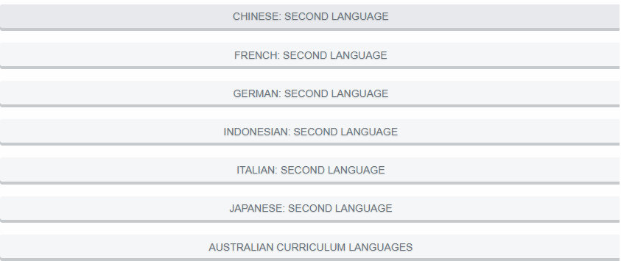
Languages
Notes:
In 2018, one language for Year 3 must be implemented.
Where possible, schools should provide Languages education from Pre-primary to Year 10. As a minimum, schools must offer:
in Years 3, 4, 5 and 6, compulsory Languages education in a minimum of one language, commencing with Year 3 in 2018 (extending to Year 4 in 2019, Year 5 in 2020 and Year 6 in 2021)
in both Years 7 and 8, compulsory Languages education in a minimum of one language, commencing with Year 7 in 2022 (and Year 8 in 2023).
In Years 9 and 10 the study of Languages is optional.
The study of one of the Aboriginal and Torres Strait Islander languages is acceptable.
Recently arrived migrants, for whom English is not their first language, may substitute English as a Second Language or further studies in English for the study of a foreign or Indigenous language.
Auslan is an acceptable alternative to the study of a language other than English.
Schools may offer a different language from those for which syllabuses are provided in the Western Australian Curriculum and Assessment Outline (e.g. Arabic, Hebrew, Hindi, Korean, Modern Greek, Vietnamese, first or background language Chinese). Where schools offer a different language (or curriculum at a different level) from those for which syllabuses are provided in the Western Australian Curriculum and Assessment Outline teachers will need to exercise their professional judgement in the adaptation of the Australian Curriculum, Assessment and Reporting Authority’s (ACARA) curriculum or alternative syllabuses.

Slide 18
Australian Curriculum Languages
http://k10outline.scsa.wa.edu.au/home/p-10-curriculum/curriculum-browser/languages
Notes:
Schools may offer a language using ACARA's curriculum or a language curriculum approved by the Authority.
http://k10outline.scsa.wa.edu.au/home/p-10-curriculum/curriculum-browser/languages

Slide 19
STEM Clarifications
STEM
is not a learning area but a pedagogy and a body of knowledge that relate to many different learning areas
does not replace the teaching of Mathematics, Technologies (Digital), Engineering or Science as published in the Outline
provides opportunities for integration
activities and assessments can use everyday materials and contexts.
The Western Australian curriculum for Science, Technologies (Digital), Engineering and Mathematics is mandated with clear reporting requirements.
Notes:
Science, Technologies, Engineering and Mathematics (STEM) does not replace the teaching of Mathematics or Science in the Western Australian Curriculum and Assessment Outline. It may provide a way of connecting learning or providing a context for learning within Mathematics and Science. However, teachers are required to teach all the curriculum content in all learning areas as published in the Outline.

Slide 20
Years 6 and 7 – Moderation Pilot
The Authority’s moderation pilot has been extended to include Humanities and Social Sciences and Science, along with English and Mathematics.
Schools from across the systems/sector will be invited to participate in Term 1.
In Term 2, participating schools will be provided with a common assessment task to complete along with a marking key to complete during the term.
Meetings will be held for each learning area in Term 3. Participating teachers will be asked to contribute student work samples prior to the meeting. These will be used during the moderation activities.
Notes:
Any questions should be directed to Mandy Hudson, Manager, Curriculum and Assessment – mandy.hudson@scsa.wa.edu.au or
9273 6755.

Slide 21
ABLEWA Update
The University of Melbourne has recently added four new assessment instruments to the ABLES Assessment Tool and they are available for use by Western Australian schools in 2018:
Critical and Creative Thinking
Digital Literacy
Mathematics
Movement and Physical Activity.
https://k10outline.scsa.wa.edu.au/home/resources/ablewa/getting-started-with-ablewa
Notes:
Any questions should be directed to Maureen Lorimer, Principal Consultant, Strategic Projects – maureen.lorimer@scsa.wa.edu.au or 9273 6397 (Tuesday, Wednesday & Friday).

Slide 22
NAPLAN Online
In 2018, NAPLAN will be available for the first time in an online format.
2018 – 277 schools have committed to participate in NAPLAN Online in May
2019 – Over 600 schools will undertake NAPLAN Online.
2020 – all Western Australian schools will undertake NAPLAN Online.
Updates will be provided throughout 2018 via eCirculars.
Notes:
2018 - All participating schools have had staff complete mandatory training with the Authority and further refresher training will be provided prior to the NAPLAN Online in May.
All Western Australian Schools participating in NAPLAN Online in 2018 will be provided with ‘backup’ paper NAPLAN test materials which will be delivered to schools by the first week of Term 2.
Schools not participating in the implementation of NAPLAN Online will be required to continue to complete NAPLAN in a paper-based format.
A comprehensive research program is also being undertaken by ACARA to investigate student performance and to monitor the impact of delivering NAPLAN Online.
2019 - For schools that are not able to access the internet to complete NAPLAN Online, alternative information technology solutions will be available.
The assessment window for schools that will complete NAPLAN in a paper-based format will remain unchanged, while the assessment window for completing NAPLAN online will be extended to nine days and will commence on the same day as the paper-based tests.
ESA and ACARA are working with the Australian Government’s Department of Education and Training to deliver this program of work, in consultation with State and Territory and non-government education authorities.
Additional information about NAPLAN Online can be found on ACARA’s website.
National Assessment Program, NAPLAN Online website.
Research and development – details on tailored tests, automated essay scoring, device suitability, student engagement and motivation, readability and layout, accessibility options: https://www.nap.edu.au/online-assessment/research-and-development
The Authority’s NAPLAN Online website: http://k10outline.scsa.wa.edu.au/home/assessment/testing/naplan-online.

Slide 23
2017 WACE – Statistics and review

Slide 24
2017 WACE and WASSA
22 174 students received a WACE and 25 954 students receiving the Western Australian Statement of Student Achievement (WASSA).
We thank you and your staff for your commitment to ensure that Western Australia’s 2017 Year 12 student cohort was so well supported.

Slide 25
2017 WACE Statistics (1)
25 954 Year 12 students undertook studies towards the WACE
24 332 full-time students were eligible to achieve a WACE
22 174 (91.1 per cent) of eligible Year 12 students achieved a WACE
13 299 Year 12 students studied four or more ATAR courses
2174 students studied 1, 2 or 3 ATAR courses
Notes:
Overall Statistics
In 2017, 25 954 Year 12 students undertook studies towards the WACE. This is an increase of 513 on the 25 441 students in 2016.
Of the 25 954 Year 12 students (25 441 in 2016), 24 332 full-time students were eligible to achieve a WACE (23 360 in 2016).
In 2017, 22 174 (91.1 per cent) of eligible Year 12 students achieved a WACE. This compares to 21 473 (91.9 per cent) in 2016.
ATAR courses: There were 13 299 Year 12 students (54.7 per cent of Year 12 students who undertook full-time studies towards the WACE) who sat four or more ATAR course examinations in 2017. In 2016, there were 13 540 Year 12 students (58 per cent) who sat four or more ATAR course examinations.

Slide 26
2017 WACE Statistics (2)
There were 662 non-sits across all examinations
There were 497 students who did not sit one or more examination
There were 261 WACE eligible students who did not sit one or more examinations
155 students were eligible for a WACE still achieved a WACE
106 students did not receive a WACE, for 20 of these students not meeting the WACE requirements was directly related to not sitting an examination
Notes:
Overall Statistics
In 2017, 25 954 Year 12 students undertook studies towards the WACE. This is an increase of 513 on the 25 441 students in 2016.
Of the 25 954 Year 12 students (25 441 in 2016), 24 332 full-time students were eligible to achieve a WACE (23 360 in 2016).
In 2017, 22 174 (91.1 per cent) of eligible Year 12 students achieved a WACE. This compares to 21 473 (91.9 per cent) in 2016.
ATAR courses: There were 13 299 Year 12 students (54.7 per cent of Year 12 students who undertook full-time studies towards the WACE) who sat four or more ATAR course examinations in 2017. In 2016, there were 13 540 Year 12 students (58 per cent) who sat four or more ATAR course examinations.

Slide 27
2017 WACE Statistics (3)
Growth of VET
86 schools had 100% of their students complete a Certificate II or higher
13 547 Year 12 students achieved at least one VET qualification at Certificate II or higher in Year 10, 11 or 12
3692 students achieved Certificate III
957 students achieved a Certificate IV
11 054 students completed Workplace Learning programs
Notes:
There were 86 schools that had 100% of their students, not enrolled in four or more ATAR courses, complete a Certificate II or higher.
In 2017, 14 774 Year 12 students achieved at least one VET qualification at Certificate II or higher in Year 10, 11 or 12, compared with 13 547 in 2016.
In 2016, there were 4 649 Certificate III or IV achieved. Comparative figures for 2016 were 4082. In 2017, 3 692 students achieved Certificate III and 957 students achieved a Certificate IV. The respective numbers in 2016 were 3 408 and 674.

Slide 28
2017 VET Industry Specific Course Achievements
VET Industry Specific Course | No. of Students | No. of Providers
Automotive | 26 | 8
Business and Financial Services | 53 | 11
Creative Industries | 10 | 3
Construction Industries | 43 | 11
Community Services and Health | 51 | 12
Engineering | 29 | 4
Hospitality and Tourism | 72 | 11
Information and Communications Technology | 33 | 4
Primary Industries | 173 | 5
Sport and Recreation | 187 | 8

Slide 29
2017 Year 12 full-time WACE eligible students
Population 24 332 | Prequalified through Year 9 NAPLAN in 2015 % | Achieved the standard through OLNA 2015–2017 % | Total demonstrating the standard by end of 2017 %
Numeracy | 55.2 (50.7) | 40.8 (45.2) | 96.0 (95.9)
Reading | 54.6 (50.4) | 43.1 (47.5) | 97.7 (97.9)
Writing | 45.1 (43.0) | 51.6 (54.3) | 96.7 (97.2)
All tests | 32.8 (28.1) | 60.7 (65.8) | 93.5 (93.9)

Slide 30
OLNA Results and Reports
LAN004 – OLNA group performance diagnostics (only available at set times).
This report includes summary diagnostics for the group of students achieving a Category 1 or Category 2 result in the selected component.
LAN005 – OLNA individual diagnostics (only available at set times).
This report includes individual diagnostics for students achieving a Category 1 or Category 2 result in the selected test round and component.
Teachers of English and Mathematics should be aware of these reports.

Slide 31
Examination Reports – Examiners’ Comments
Students should:
write legibly and use a black or blue (non-gel) pen
read the question and note the verb/s
some questions are in two parts and involve more than one verb
note the number of marks for the question
plan their answer when writing extended responses.
Teachers should:
teach the syllabus, not the textbook.
Notes:
The use of gel pens emerged as an issue during the exams because of the impact of scanning.
Geography and Psychology will be added to the courses marked online in 2018.
Teachers should not be relying on text books and ensuring that they are implementing the syllabus requirements for a course.

Slide 32
Externally Set Tasks – Mean Comparison
Note: in 2018, tolerances will move to 10%
Notes:
EST010 – Mean school mark vs mean SCSA marker mark graph
Useful for checking comparative performance against state or internally across contexts
Warn that the tolerances for 2018 will drop from 15% to 10%
For the second graph in this course there is a significant group of schools where the school interpretation of standards is apparently higher than the interpretation of the markers. This state-wide pattern deserves investigation. Possible reasons could be that there is still
a hangover of Stage 1 standards being applied
Course content dot points are interpreted too simplistically e.g. in some Foundation courses
possible solutions for schools would be to review the samples provided on Authority website, also review the sample tasks provided online and examine the language of the course grade descriptions
NOTE if the aberrant grouping in graph two was the opposite i.e. teachers marking too hard what could be a suggested reason/ Interestingly this can happen in subjects where ATAR and General students are combined in the same class. There can be a tendency for teachers to judge students against the ATAR course expectations rather than the General expectations.
This is about understanding standards.
Validation of the number of ‘C grades’ awarded in General courses.
Sampling

Slide 33
EST011 – School Mark v SCSA Reviewer Mark
Notes:
Note the bottom two rows in this table – two classes in the same school (compare class to class).
Lines of Inquiry:
Differences between classes in relation to external marker parity?
What were the internal moderation processes for marking?
Why was the pattern of class with four outside tolerance samples all significantly higher than the external marker?
The graph shows how the EST is working.

Slide 34
EST014 School Mark Frequency
Notes:
Implications for Deputy Principal discussions when working with HoLAs:
Does the school pattern reflect the school understanding of the student capabilities?
Does the school pattern reflect the school expectation of proposed grades?
What possible reasons are there for the school population fitting where it does in the state pattern? Possible reasons could be the nature of the students, demand pitch of tasks delivered against the content dot points, misinterpretation of demand of content …… but it is useful to think and inquire for possible reasons

Slide 35
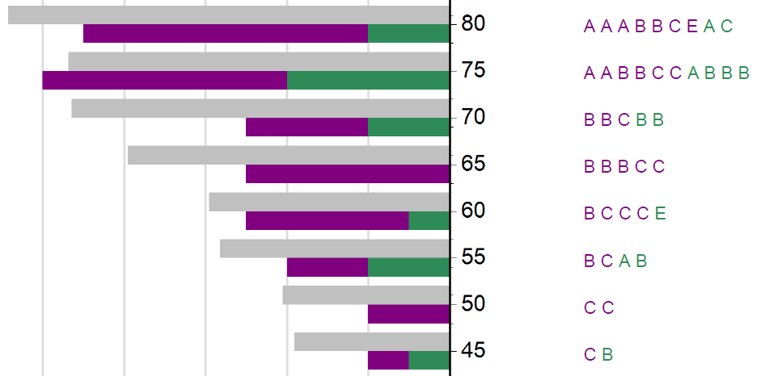
EST018 Percentage Scores and Grades (new report)
Notes:
This new report shows the frequency of all EST results as a percentage (state distribution) and places your students final school grades on the same scale.
It would be expected that students would consistently demonstrate the attributes of the grade descriptions throughout the year.
Implications for discussions:
The pitch of the Unit 3 and 4 courses in General units has been raised. Does further clarification on the pitch of the course content need to be sought?
Have the students performed consistently throughout the course on a range of assessment tasks?
Is the pitch of assessment tasks for the year similar to the pitch of the EST?
Is there a correlation between the state distribution of EST marks and the distribution of school grades?

Slide 36
Western Australian CERTIFICATE OF EDUCATION (WACE) – 2018

Slide 37
WACE Manual 2018
Describes policies and procedures to be followed in relation to achieving the WACE
Produced by the School Curriculum and Standards Authority to inform principals, other school administrators, teachers, students and parents of the requirements for the WACE
Notes:
The WACE Manual 2018 (http://www.scsa.wa.edu.au/publications/wace-manual) describes policies and procedures to be followed in relation to achieving the WACE in 2018. It is produced by the School Curriculum and Standards Authority to inform principals, other school administrators, teachers, students and parents of the requirements for the WACE.
Principals should ensure that school policy documents for students who are in Year 11 and Year 12 in 2018 are consistent with information in the WACE Manual.
The Authority website and 11to12Circulars should be checked regularly for updated information about the WACE.

Slide 38
WACE Checker
The WACE Checker is a tool which Year 12s can use to check their progress towards meeting the requirements of the WACE.
It is designed to determine whether you have met (or are expected to meet) each of the requirements for the WACE.
The WACE Checker is easy to use and is available at: https://wacechecker.scsa.wa.edu.au/wace.

Slide 39
WACE Checker – Start Screen
Notes:
We encourage schools to share awareness of the tool with their Year 12 students.
They can use it at home with their parents, or at school in conjunction with year coordinators or school admin staff if they are considering making changes to their education program.
There is a shared responsibility with the school and the student to ensure students remain WACE eligible should they make changes to the learning program and/or to monitor their grades.
Students enter information about their enrolments and achievements, the WACE checker generates a report that shows progress towards WACE achievement.
Students can save the information, print it, email it to one or more people and if required, access the information at a later date to make changes.
For example, every year, we encounter the problem of students not achieving their WACE because they don’t have a List B subject, or enough unit equivalence. This could be avoided by using the WACE Checker as a tool if students are seeking to make changes to their education program.

Slide 40
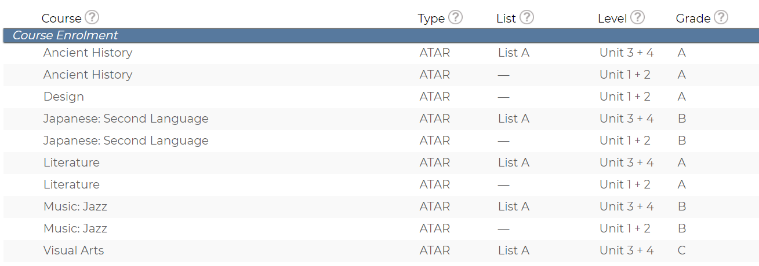
WACE Checker – Summary

Slide 41
2018 WACE Requirements and Deadlines
Students who do not sit the ATAR course examination will not:
have a course mark or grade recorded on their WASSA
receive an ATAR course report
have the pair of units completed in that year contribute towards any of the WACE requirements.
Notes:
Students who are enrolled in a Year 12 ATAR course pair of units are required to sit the ATAR course examination— even if they are only enrolled in one ATAR course.
There are both written and practical examinations for some ATAR courses.
From 2017, students who do not sit an ATAR course examination and do not have an approved sickness/misadventure application for that course, will not have the grades for the pair of units completed in that year contribute to the calculation of the Western Australian Certificate of Education (WACE).
This means, the grades for the ATAR Year 12 course will not contribute to the:
completion of a minimum of 20 units, including 10 Year 12 units
completion of at least one pair of Year 12 units from an English course (if the ATAR Year 12 course was either English, Literature or English as an Additional Language or Dialect)
completion of one pair of Year 12 units from List A (arts/languages/social sciences) or List B (mathematics/science/technology) {depending on the list of the ATAR Year 12 course}
achievement of at least 14 C grades or higher, including at least six C grades in Year 12 units
completion of at least four Year 12 ATAR courses.
Before 2017, the grades for the pair of units completed in that year did not contribute to meeting the achievement standard, but they could count in the breadth and depth requirement. This is no longer the case.
Students who do not sit the ATAR course examination will not have a course mark or grade recorded on their Western Australian Statement of Student Achievement (WASSA), nor will they receive an ATAR course report.
As a consequence, a student may not meet the requirements to receive a WACE.
The Authority advises consultation with students who may be enrolled in ATAR course/s but who are not requiring an ATAR to confirm that they must sit the examination for that course for it to contribute to their WACE.

Slide 42
2018 Consensus Moderation – ATAR Courses
Applied Information Technology
Chemistry
English
Mathematics Applications
Mathematics Methods
Media Production and Analysis
Modern History
Music
Philosophy and Ethics
Physical Education Studies
Politics and Law
Visual Arts
Notes:
Consensus moderation in 2018 will be conducted for Year 12 ATAR courses only, to support the SDA (Year 12 ATAR in 2018) and for some Year 12 General courses that were not included in the 2017 consensus moderation process.

Slide 43
2018 Consensus Moderation – General Courses
Automotive Engineering and Technology
Building and Construction
Drama
Integrated Science
Religion and Life
Notes:
Consensus moderation in 2018 will be conducted for Year 12 ATAR courses only, to support the SDA (Year 12 ATAR in 2018) and for some Year 12 General courses that were not included in the 2017 consensus moderation process.

Slide 44
Foundation Course – Eligibility Changes
Students who are yet to sit either NAPLAN or the online literacy and numeracy assessment (OLNA)
Where students have no prior NAPLAN or OLNA test evidence, schools will be able to make a professional judgement on their abilities, and if appropriate, apply to enrol them into Foundation courses from the start of Year 11.
OLNA results and Year 11 enrolments in Foundation course units
In some circumstances, schools may apply to the Authority seeking permission for a student to remain in the Foundation course/s.
WACE Manual 2018 p. 9
Notes:
These changes are on the basis of exceptional circumstances.
In October 2017, schools were advised that we had responded to feedback and made some changes to the eligibility rules for enrolment in Foundation courses.
From 2018, schools can apply, on an individual basis for students to be enrolled in Foundation courses if they have not yet sat NAPLAN or OLNA or schools consider it would be educationally beneficial for a student to remain in a Foundation course for 2018.
In some circumstances, schools may apply to the Authority seeking permission for a student to remain in the Foundation course/s.
This may be for students who have recently arrived from overseas or interstate and have no NAPLAN record.
For students who have demonstrated the minimum standard in literacy and/or numeracy in Semester 1 of Year 11, who the school wishes to stay enrolled in the relevant List A/B Foundation courses, comprehensive evidence must be provided in the application.
Applications will be sent for consideration and approval by Russell Dyer, Executive Director – Examinations, Certification and Testing.
This is not a blanket change to eligibility, there needs to be very clear evidence from the school showing why it would be educationally beneficial for an individual student to remain in a Foundation course.
The application form can be downloaded from our website.
The Authority will conduct an audit of enrolments in Foundation course units undertaken where a significant change to foundation enrolments is identified.

Slide 45
Two mathematics ATAR courses (1)
The two mathematics ATAR courses had different examination marks distributions. Scaling procedure adjusted combined scores taking account of their difficulty and ability of students completing these two courses.
Notes:
Students should be counselled into an appropriate mathematics course aligned to their interests, ability and future studies. Students who are intending on further studies at university in courses involving mathematics, such as engineering, science and economics, will be better served by studying Mathematics Methods (MAM). By studying MAM at school students will be exposed to mathematics concepts and content that will enable them to enrol in university courses without the need to enrol in mathematics bridging courses.
Each of the mathematics courses has specific content that do not follow the same hierarchical structure for the course content and difficulty that was found in the mathematics courses prior to 2016. As a result, MAM and Mathematics Applications (MAA) are not comparable.
The graphs provide the percentage frequency distributions for the examination marks and scaled scores for MAM and MAA. The distribution of examination marks show that MAA with a mean of 63.95 has a normally shaped distribution while MAM with a mean of 69.37 has a skewed distribution.
The scaling process applied to both MAM and MAA takes into account the difficulty of the courses and the ability of the students completing these two courses and adjusts the standardised combined scores accordingly.

Slide 46
Two mathematics ATAR courses (2)
The two mathematics ATAR courses had different examination marks distributions. Scaling procedure adjusted combined scores taking account of their difficulty and ability of students completing these two courses.
Notes:
For the same standardised combined score the scaled for MAM is higher than MAA by about 10 scores.
The graph suggests that for the MAM and MAA students with the combined scores at the same percentile ranks in each course, MAM students will receive higher AMS scaled scores than MAA students.

Slide 47
Research Course/Extended Investigation
Investigation will commence this year on the development of a Research Course for both General and ATAR.
The courses would provide students with the opportunity to develop, refine and extend knowledge and skills in independent research and carry out an investigation that focuses on a rigorous research question.
Professor Jim Tognolini will be engaged to assist in defining elements of the Research Course particularly on the measurement of critical and creative thinking skills.

Slide 48
Retention of Student Work – Option 1
The school establishes an assessment file for each student which:
contains all marked written assessment tasks, and can be accessed by the student for revision purposes
is retained by the school until the results are accepted by the Authority
is returned to the student within a specified period after the results are accepted by the Authority or is securely disposed of by the school.
2.8.2 WACE Manual 2018 p. 34
Notes:
Option 1 - School takes responsibility for retaining work.

Slide 49
Retention of Student Work – Option 2
The school does not physically retain students’ written work:
students are responsible for retaining all of their marked written assessment tasks
the School Assessment Policy advises students that the Authority may request access to student assessed work during the school year
non provision of assessed work by a student for the purpose of Authority grade validation or moderation processes may impact on the Authority approval of final grades.
2.8.2 WACE Manual 2018 p. 34
Notes:
Option 2 - Student takes responsibility for retaining work.
This has possible consequences for students and this MUST be spelt out in school assessment policy if school goes down this pathway

Slide 50
Non-approval of School Grades
Based on feedback, the timeline for the implementation of the process will now commence in 2019.
The ‘Notice of Intent’ will specify, in detail, the process, requirements and timeline that a school must comply with.
In the event of continued non-compliance, the Authority will not accept the school grades for the pair of units at the end of the year.
In this case, the Authority will apply adjusted grades.

Slide 51
Non-approval of School Grades – Sequence (1)
School identified for a grading review
Conduct initial grading review (mid-Term 1 onwards)
Principal Consultant
If high level of non-compliance, issue Notice of intent – potential non-approval of grades
Conduct follow-up grading review (1–3 weeks post-first visit)
Principal Consultant and senior practicing teacher
If high level of non-compliance remains, issue Confirmation of notice of intent to not approve grades
Moderation program concludes (mid-Term 3)
Notes:
A grading review can be initiated as a result of a number of mechanisms, including:
syllabus delivery audit
school moderation visit
school moderation mail-in
proposed grade feedback
final grade feedback
analysis of ATAR examination data.
The sequence is linked to milestones identified in the Activities Schedule and allows for due process at a school level. This supports the school in meeting its obligations and timelines.

Slide 52
Non-approval of School Grades– Sequence (2)
Review the submitted proposed grade distributions (last two weeks of Term 3)
Principal Consultant
If the grade distribution is not approved, conduct a single follow-up grading review (one week’s notice)
Principal Consultant and senior practicing teacher
If high level of non-compliance is evident, re-issue Confirmation of Notice of intent to not approve grades

Slide 53
Non-approval of School Grades– Sequence (3)
Compare proposed grade distributions and achievement data against the final grade distributions (first two weeks in October).
If non acceptable variation to advised grade distribution exists:
issue Authority-approved grades
indicate opportunity for appeal process.
Issue statement of outcome of appeal to provider.

Slide 54
Adjustments for students

Slide 55
OLNA – Disability Adjustments
Adjustments will be made to OLNA conditions if a student’s access to the assessment is significantly affected by a disability, impairment, illness or impediment.
Evidence of a disability diagnosed by a relevant medical professional is required for adjustment.
https://senior-secondary.scsa.wa.edu.au/assessment/disability-adjustment-guidelines
Notes:
Refer to the Guidelines for disability adjustments for timed assessments on the Authority website.

Slide 56
OLNA – Provisions for EAL/D Students
Students registered as eligible to be enrolled in a Year 12 EAL/D courses will be granted an extra ten minutes to complete the reading, writing and numeracy components of the OLNA.
Students may apply for EAL/D eligibility from when they are in Year 9.
Students do not need to re-apply for EAL/D eligibility every year.
https://senior-secondary.scsa.wa.edu.au/syllabus-and-support-materials/english/english-as-an-additional-language-or-dialect
Notes:
Students who are registered as eligible to be enrolled in a Year 12 EAL/D course will be granted an extra ten minutes to complete the reading, writing and numeracy components of the OLNA. Students may apply for EAL/D eligibility from when they are Year 9 in order to receive the extra time from the first time that they sit OLNA in Year 10.
Students must complete and submit an eligibility application for a Year 12 EAL/D course by the published deadlines in order to be approved in time for the OLNA tests. Schools can generate a report in SIRS to find out the outcome of EAL/D eligibility applications that have been submitted. All the information, applications and supporting documents can be found on the EAL/D page of the SCSA website:
https://senior-secondary.scsa.wa.edu.au/syllabus-and-support-materials/english/english-as-an-additional-language-or-dialect
Students are not required to subsequently enrol in a Year 12 EAL/D course, however they must have been found eligible to enrol in order to be granted the extra time. Students do not need to re-apply for EAL/D eligibility every year; one application is sufficient to determine their eligibility status for the duration of their schooling.

Slide 57
Special Provisions for ATAR Examinations
Special examination arrangements
Candidates who have a temporary or permanent disability, illness and/or specific learning disability that could disadvantage them in timed assessments
Comprehensive evidence required that includes a diagnosis and demonstrated functional impact
Application is made prior to the examination
Sickness/misadventure provisions
Candidates who suffer from a temporary sickness, non-permanent disability or an unforeseen event close to or during the examinations
Application is made immediately after the examination

Slide 58
Alternative Practical Examinations
Alternative Physical Education Studies and Dance ATAR practical examinations are for students with a long-term injury.
The school needs to apply by Friday, 27 July for students to sit the alternative practical examination.
If there is any doubt that a student will be fit for the practical examination, the school should submit an application.
Students with a long-term injury are not eligible for sickness/misadventure consideration.
Students who do not sit the practical, and are not eligible for sickness/misadventure consideration, do not complete the course.

Slide 59
2018 – communications and processes

Slide 60
Communications
Messages for staff in schools are communicated via the 11to12 and Kto10 Circulars.
Teachers should sign up to receive these.
Letters to Principals with important information are emailed. Principals are expected to share the letters with their staff.
These communications are then published on the Authority’s website.

Slide 61
2018 Key Dates for Year 12
There are no more changes to enrolments in ATAR, General, Foundation, Preliminary and VET industry specific courses for Year 12 students and VET qualification estimates (ESQUAL) after Thursday 5 April.
ESTs must be administered between Monday 7 to Friday 25 May.
Year 12 students are able to withdraw from ATAR courses with practical examination components up until 27 July and from ATAR courses which do not have practical examination components up until 17 August.
Year 12 students are able to withdraw from General, Foundation, Preliminary and VET industry specific courses up until Friday 17 August.
Notes:
EST dates have changed to Week 2 Term 2.

Slide 62
New Process to Update SIRS Contacts
Instructions have been provided to schools.
Incorrect or omitted contact details in SIRS may result in schools not receiving important communications.
Remember to update SIRS if there are any changes to key contacts during the year.

Slide 63
Concluding remarks

Slide 65
Copyright
© School Curriculum and Standards Authority, 2018
This document – apart from any third party copyright material contained in it – may be copied for non-commercial purposes in Western Australian schools, and in schools offering the Western Australian Certificate of Education (WACE), provided that the School Curriculum and Standards Authority is acknowledged as the copyright owner.
The document may not be copied for any other purpose. The document ─ including any third party copyright material contained in it ─ must not be communicated to the public on an intranet, an extranet, or an internet site.
Any content in this document that has been derived from the Australian Curriculum may be used under the terms of the Creative Commons Attribution 4.0 International (CC BY) licence.

